Slide 1
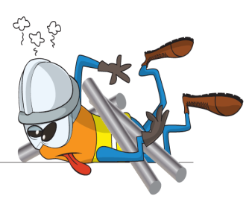
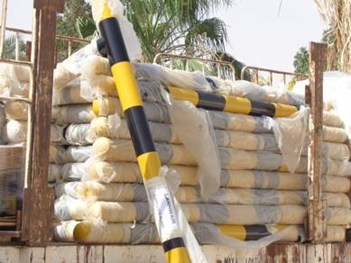
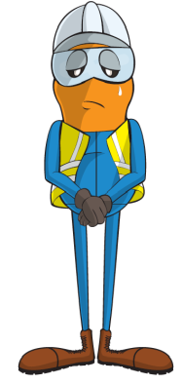
PDO Incident First Alert
Incident type | LTI(#15) | PIM ID | 1089190
Date/ time | 11/04/2015 (10:30 hrs) | Directorate
Location | PDO camp - Lekhwair | Dept
What happened
A stack of barrier posts protected by polyethene were being off loaded from the rear of a trailer by a helper standing on the ground. As he pulled one of the barriers his grip slipped and the barrier struck him on left thumb causing a fracture and a deep cut.
Mr. Musleh asks the questions of can it happen to you?
Do you work at the right height to avoid over reaching?
Do you have the necessary help for difficult tasks?
Do you always wear gloves when you need to?
Do you always pay attention when doing difficult tasks?
Barrier slipped down
Please disseminate this LTI notification to your teams and use it in your tool box talks and HSE meetings and notice boards.

