Slide 1
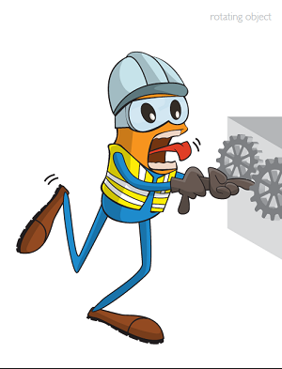
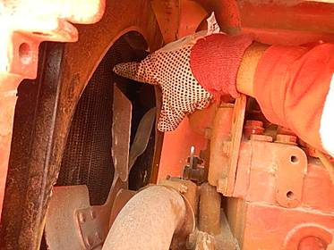
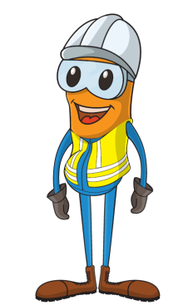
PDO Incident First Alert
Incident type | LTI(#12) | PIM ID | 1089107
Date/ time | 04/04/2015 (16:00hrs) | Directorate
Location | Rig#21 Operating in Abuthailah | Dept
What happened
Whilst a welder was manually checking a leaking hose from a radiator his finger became trapped in the radiator fan and he fractured his index finger .
Can the task be done using ‘hands off’ principle?
Are you competent to do the job?
Have you isolated rotating parts?
Please disseminate this LTI notification to your teams and use it in your tool box talks and HSE meetings and notice boards.

