Slide 1
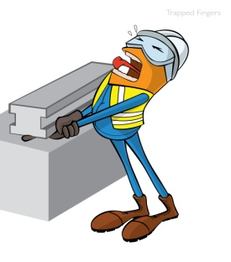
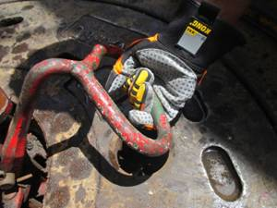
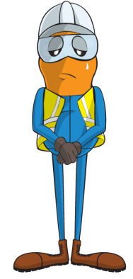

PDO Incident First Alert
Incident type | LTI(#13) | PIM ID | 1089195
Date/ time | 11/04/2015 (12:500 hrs) | Directorate
Location | Rig-69 - Burhan West, QA area | Dept
Finger that was trapped
What happened
While running in the hole, and setting the slips the floorman stooped down and grabbed the slips handle. Whilst holding them his fingers became trapped between the handle and the steel toe cap of his boot causing him to lose part of his finger.
Mr. Musleh asks the questions of can it happen to you?
Do you report equipment that is broken or deformed?
Do follow up on maintenance requests that don’t get done?
Do you look out for points where you fingers may get hurt?
Do you pay attention to your work and the hazards?
Safety boot pinch point
Please disseminate this LTI notification to your teams and use it in your tool box talks and HSE meetings and notice boards.

