Slide 1
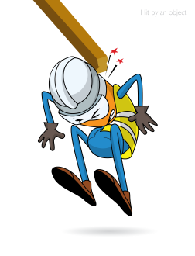
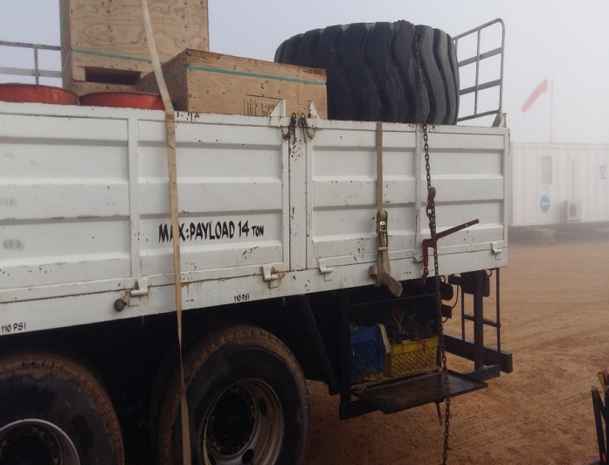


PDO Incident First Alert
Incident type | LTI(#16) | PIM ID | 1089293
Date/ time | 16/04/2015 (06:45 hrs) | Directorate
Location | Marmul | Dept
What happened
A truck driver was using a chain binder to secure a load on his trailer. He pushed the lever down to lock it in place using a cheater bar but the chain binder had not fully locked and as he removed the cheater bar the lever under high tension swung up violently and hit him in the face causing severe injury to his right eye.
Point of impact
Mr. Musleh asks the questions of can it happen to you?
Should you be using a chain binder which involves high risk?
Can you use other methods to secure your load like ratchet straps?
Do always stay out of the line of fire of anything that can hurt you?
Please disseminate this LTI notification to your teams and use it in your tool box talks and HSE meetings and notice boards.

