Slide 1
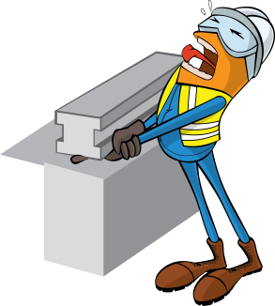
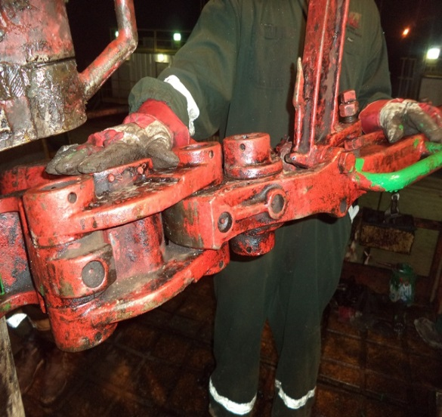
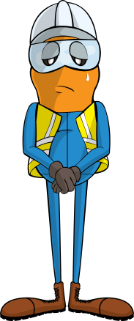

PDO Incident First Alert
Incident type | LTI(#18) | PIM ID | 1089249
Date/ time | 16/04/2015 (01:15 hrs) | Directorate
Location | Qaharer, near Marmul | Dept
What happened
While running in the hole the rig crew were changing the elevation of the manual tongs. A roustabout went to move the tongs so they would not hit the tubing elevator but in doing so his fingers became trapped between the elevator and tongs fracturing his finger.
Tubing elevator
Mr. Musleh asks the questions of can it happen to you?
Tongs
Do you keep an eye out for where your fingers might be crushed?
Do keep your hands and fingers out of crush points?
Do you wear impact gloves when on the rig floor?
Lifting Sub
Please disseminate this LTI notification to your teams and use it in your tool box talks and HSE meetings and notice boards.

