Slide 1
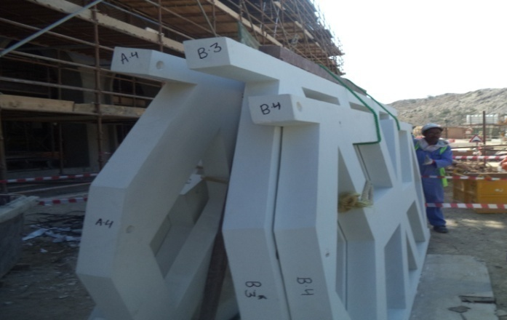
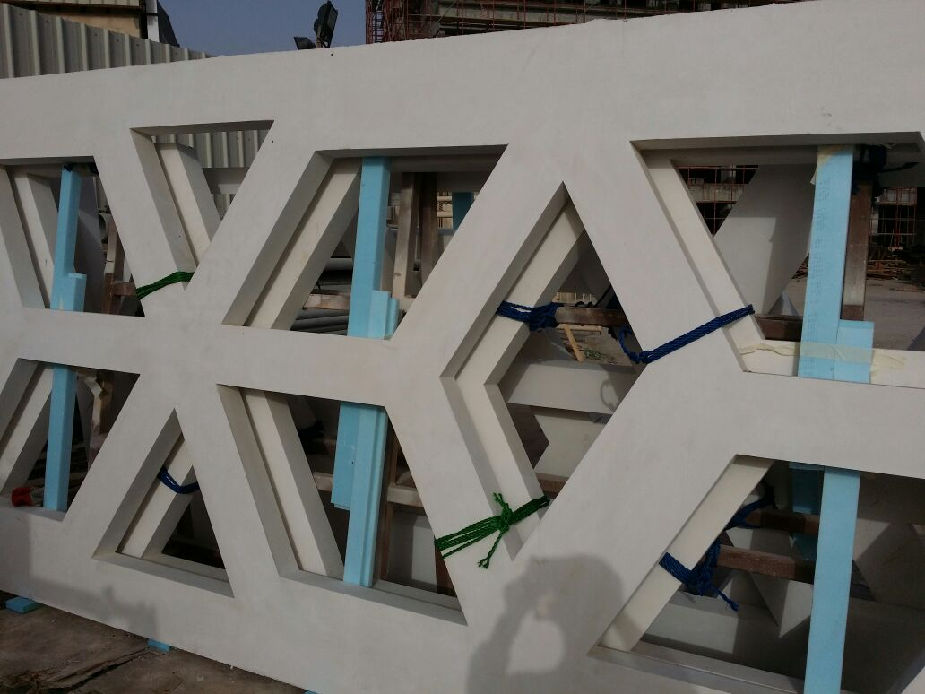
PDO Safety Advice
Use this Advice: Discuss in Tool Box Talks and HSE Meetings ➔ Distribute to contractors ➔ Post on HSE Notice Boards ➔ Include in site HSE Induction
Date:05-02-2015
Injury:Fractured leg
What happened?
A team were unloading GRC panel’s from a trailer. The team left one man holding the 400kg panel upright. He began to lose control of the panel and so the team ran back to help, however the panel fell on the masons left leg resulting in a fracture.
Your learning from this incident:
Method statement should include procedure for securing the load and it should be communicated to the work force.
TRIC to be carried out for each and every activity.
Ensure correct planning and risk assessment for the work
Contact MSE34 for further information Learning No 06 05/02/2015

Slide 2
Management learning's
Distribute to contractors ➔ Post on HSE Notice Boards
Date:05-02-2015
Injury: Fractured leg
As a learning from this incident and ensure continual improvement all contract
managers are to review their HSE HEMP against the questions asked below
Confirm the following:
Are TRIC cards completed for all activities?
Have you identified all the risks associated with the task?
Have you communicated the risks to the workforce?
Method statement and working procedure explained to the workforce?
Learning No 06 05/02/2015

