Slide 1
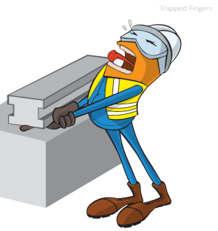
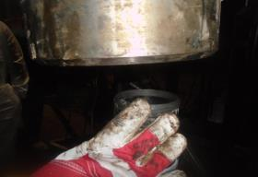
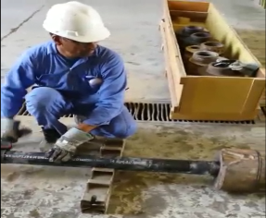
PDO Safety Advice
Use this Advice: Discuss in Tool Box Talks and HSE Meetings ➔ Distribute to contractors ➔ Post on HSE Notice Boards ➔ Include in site HSE Induction
  Date: 12-02-2015.
  Injury : Finger injury
What happened?
While IP was connecting tubing hanger to the tubing joints his right index
finger got crushed between the rings at tubing joint & internal threads of
the hanger.
Your learning from this incident..
Tubing Hanger should not be assembled on Rig floor in vertical position.
Right way to assemble the tubing hanger with corrosive insertion ring and corrosive barrier ring and pup joint is to do make up on the ground floor in horizontal position.
Review Procedures (SOP, JSA etc) periodically
Always keep fingers away from the pinch point (Hand’s Off)
Always apply “Empowerment to STOP unsafe work”.
Tubing hanger must always be assembled in horizontal position.
Contact MSE34 for further information Learning No 07 12/02/2015

Slide 2
Management learning's
Distribute to contractors ➔ Post on HSE Notice Boards
  Date: 12-02-2015.
  Injury : Finger injury
As a learning from this incident and ensure continual improvement all contract
managers are to review their HSE HEMP against the questions asked below
Confirm the following:
Have you ensured the SOP & JSA are covering all the jobs to be carried out ?
Is the Operational Team aware of the latest SOP & JSA?
Do you encourage your employees to exercise “Empowerment to STOP Unsafe Work”?
Do you check the training compliance of the employees?
Learning No 07 12/02/2015

