Slide 1
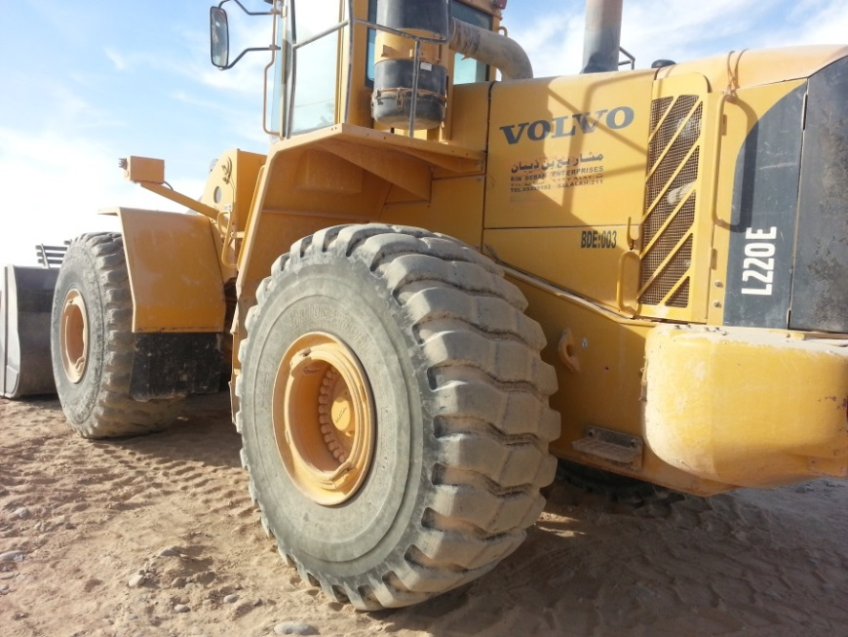
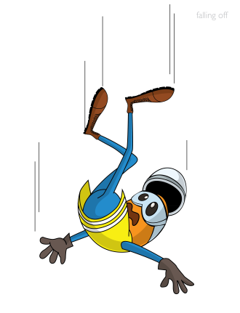
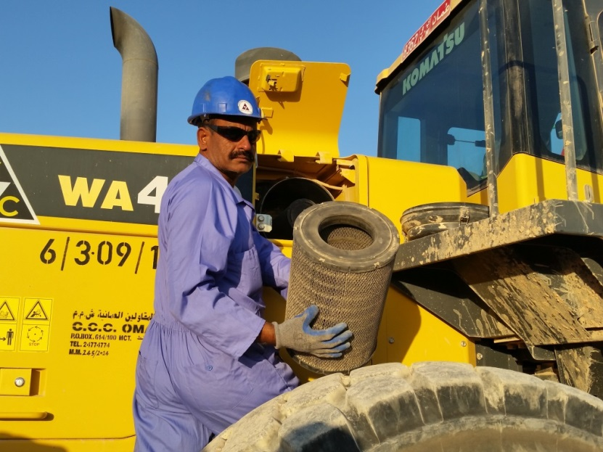
PDO Safety Advice
Use this Advice: Discuss in Tool Box Talks and HSE Meetings ➔ Distribute to contractors ➔ Post on HSE Notice Boards ➔ Include in site HSE Induction
Date: 03/02/2015
Injury: Fall from height
What happened?
An operator of wheel loader fell down while cleaning air filter of his equipment, causing a fracture to his right wrist.
Your learning from this incident..
Do not take short cuts from the normal safe practice & procedure while undertaking maintenance.
No work shall be undertaken without supervision outside of normal working hours.
Do not take short cuts .
Contact MSE34 for further information Learning No 08 03/02/2015

Slide 2
Management learning's
Distribute to contractors ➔ Post on HSE Notice Boards
Date: 03/02/2015
Injury: Fall from height
As a learning from this incident and ensure continual improvement all contract
managers are to review their HSE HEMP against the questions asked below
Confirm the following:
Does your HEMP cover all tasks associated with the job?
Do you have a clear instruction about working out of normal working hours?
Do you check the training compliance of your employees?
Learning No 08 03/02/2015

