Slide 1
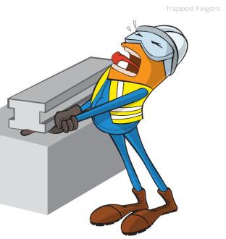
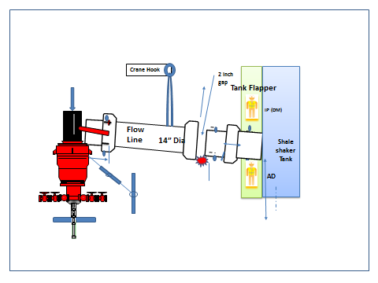
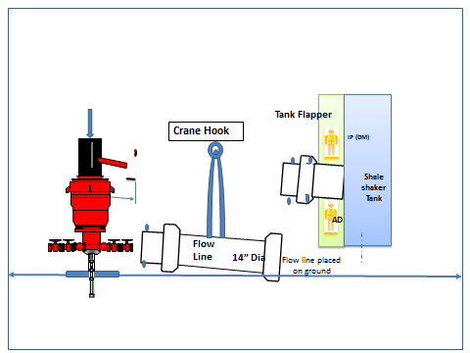
PDO Safety Advice
Use this Advice: Discuss in Tool Box Talks and HSE Meetings ➔ Distribute to contractors ➔ Post on HSE Notice Boards ➔ Include in site HSE Induction
Date: 26/02/2015
Injury: Fractured finger
What happened?
A leak was observed in a connection between the shale shaker sliding pipe
and the flow line connected to the bell nipple. The sliding pipe was partially
dismantled from the flow line and IP attempted to check the rubber seal on
the flow line with his hand. At that moment, a sudden movement occurred
on the flow line causing the IP right hand index finger to become trapped
between the sliding pipe & the flow line causing a fracture to his finger.
Your learning from this incident….
Keep your hands away from the crush points.
Intervene and stop the task if someone new joins your team without attending the pre-job safety meeting.
Place the flow line on the ground for checking & repair work.
Flow line was not dismantled & placed on ground to inspect the rubber seal.
Always keep your hands & fingers away from crush points.
Flow line dismantled and placed on ground to check the rubber seal.
Contact MSE34 for further information Learning No 09 26/02/2015

Slide 2
Management learning's
Distribute to contractors ➔ Post on HSE Notice Boards
Date: 26/02/2015
Injury: Fractured finger
As a learning from this incident and ensure continual improvement all contract
managers are to review their HSE HEMP against the questions asked below
Confirm the following:
Have you identified the risks if there is concurrent operation?
Does your TBT cover these risks?
Do you have an up to date procedure for the task?
Learning No 09 26/02/2015

