Slide 1
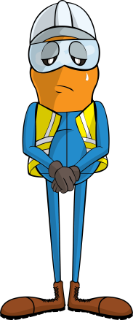
PDO Incident First Alert
Incident type | LTI(#19) | PIM ID | 1089498
Date/ time | 06/05/2015 (23:00 hrs) | Directorate
Location | Zareef-8, near Bahja | Dept
What happened
During rigging-up the work floor, the support legs were being lifted from the v-door, by winch using a tugger line. The Derrick man was guiding the tugger line with his left hand. As the support leg came off the v-door, it dropped slightly crushing his finger against the cat walk resulting in a fracture of the tip of his right hand ring finger.
Mr. Musleh asks the questions of can it happen to you?
Do you keep an eye out for where your fingers might be crushed?
Do keep your hands and fingers out of crush points?
Can the task be done using “hands off” principal?
Please disseminate this LTI notification to your teams and use it in your tool box talks and HSE meetings and notice boards.

