Slide 1
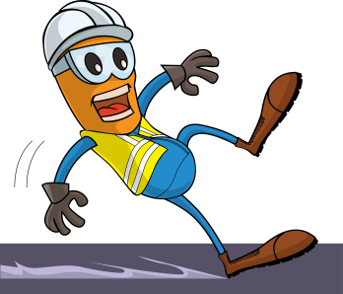
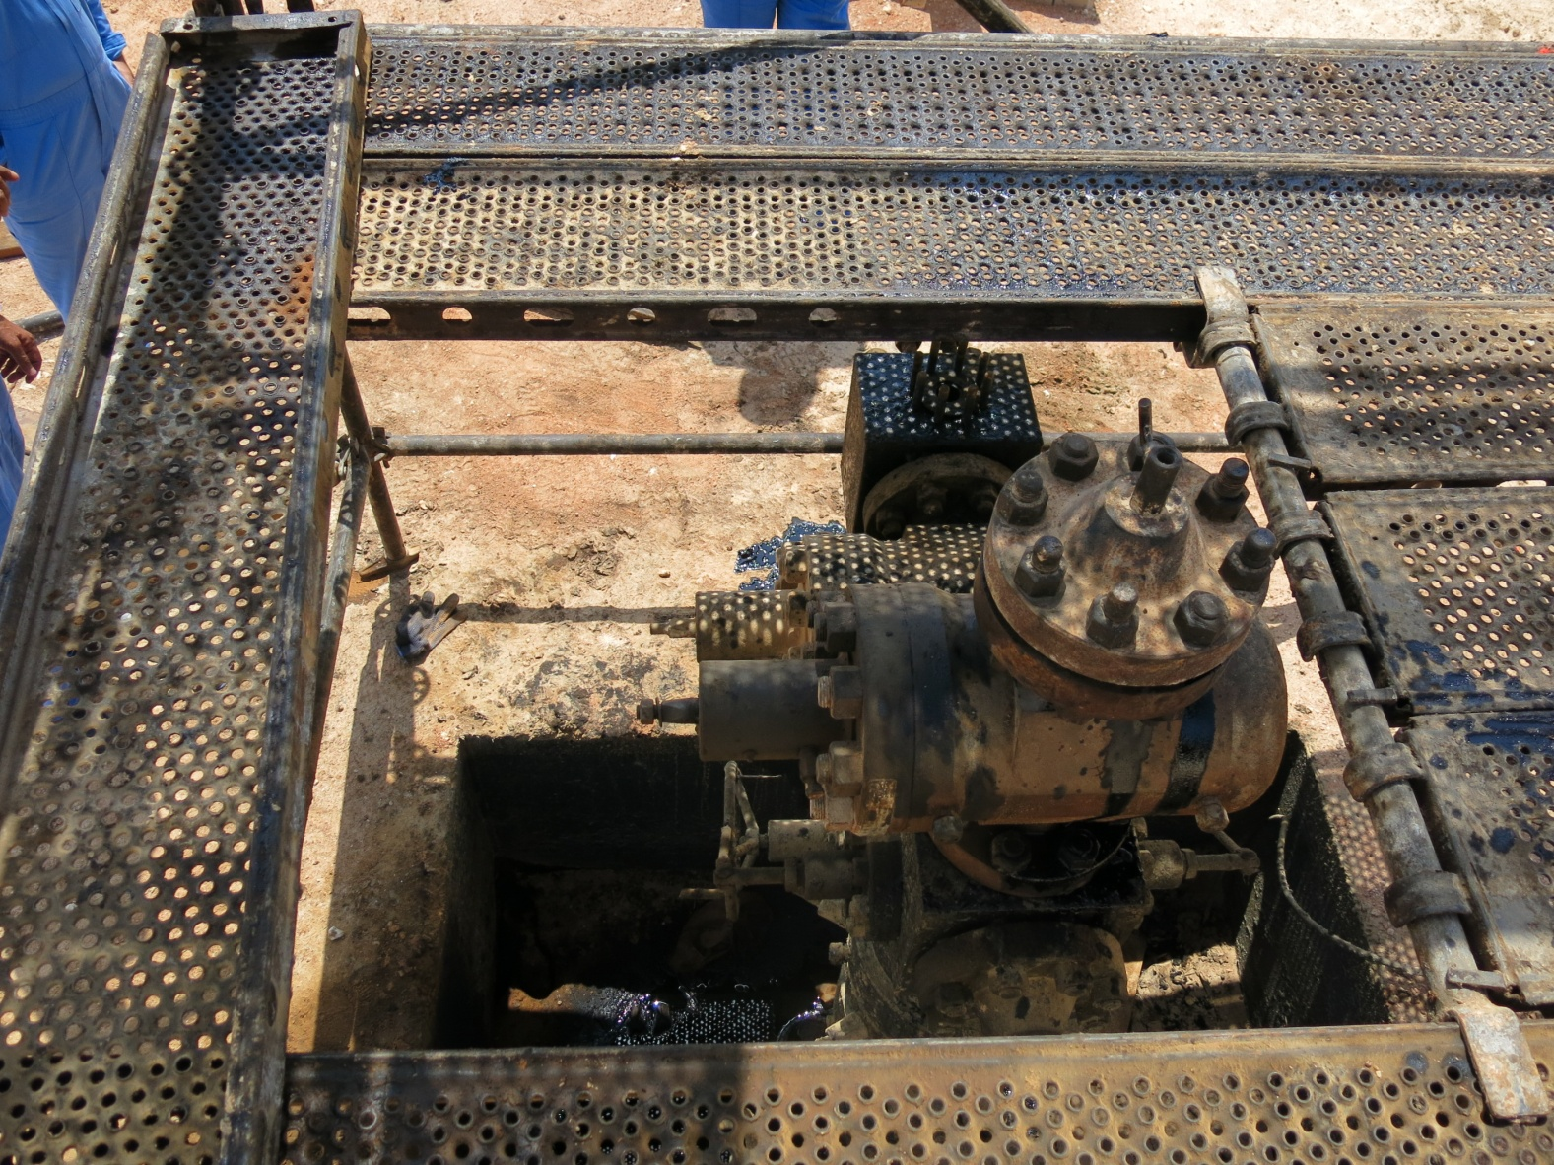
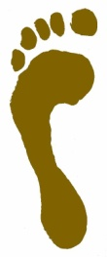
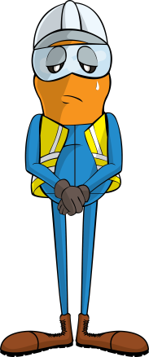
PDO Incident First Alert
Incident type | LTI(#20) | PIM ID | 1089660
Date/ time | 23/05/2015 (08:30 hrs) | Directorate
Location | Amal | Dept
What happened
After completing rigging down the top section of the scaffolding, a technician began removing a plank (1m section of scaffolding grating). When he tried to push the plank up with the hammer and his hands, he slipped and fell on to the xmas tree and hit his hand against the xmas tree suffering a fracture to his upper right arm.
Xmas tree
Mr. Musleh asks the questions of can it happen to you?
Do you have an agreed scaffold for work around the well head?
Do you ensure safety barriers are in place to prevent falls?
Do you ensure safety harnesses are worn when in danger of falling from height?
Technician position
Please disseminate this LTI notification to your teams and use it in your tool box talks and HSE meetings and notice boards.

