Slide 1
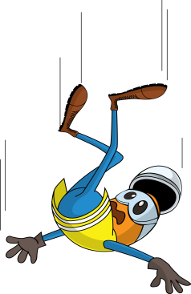

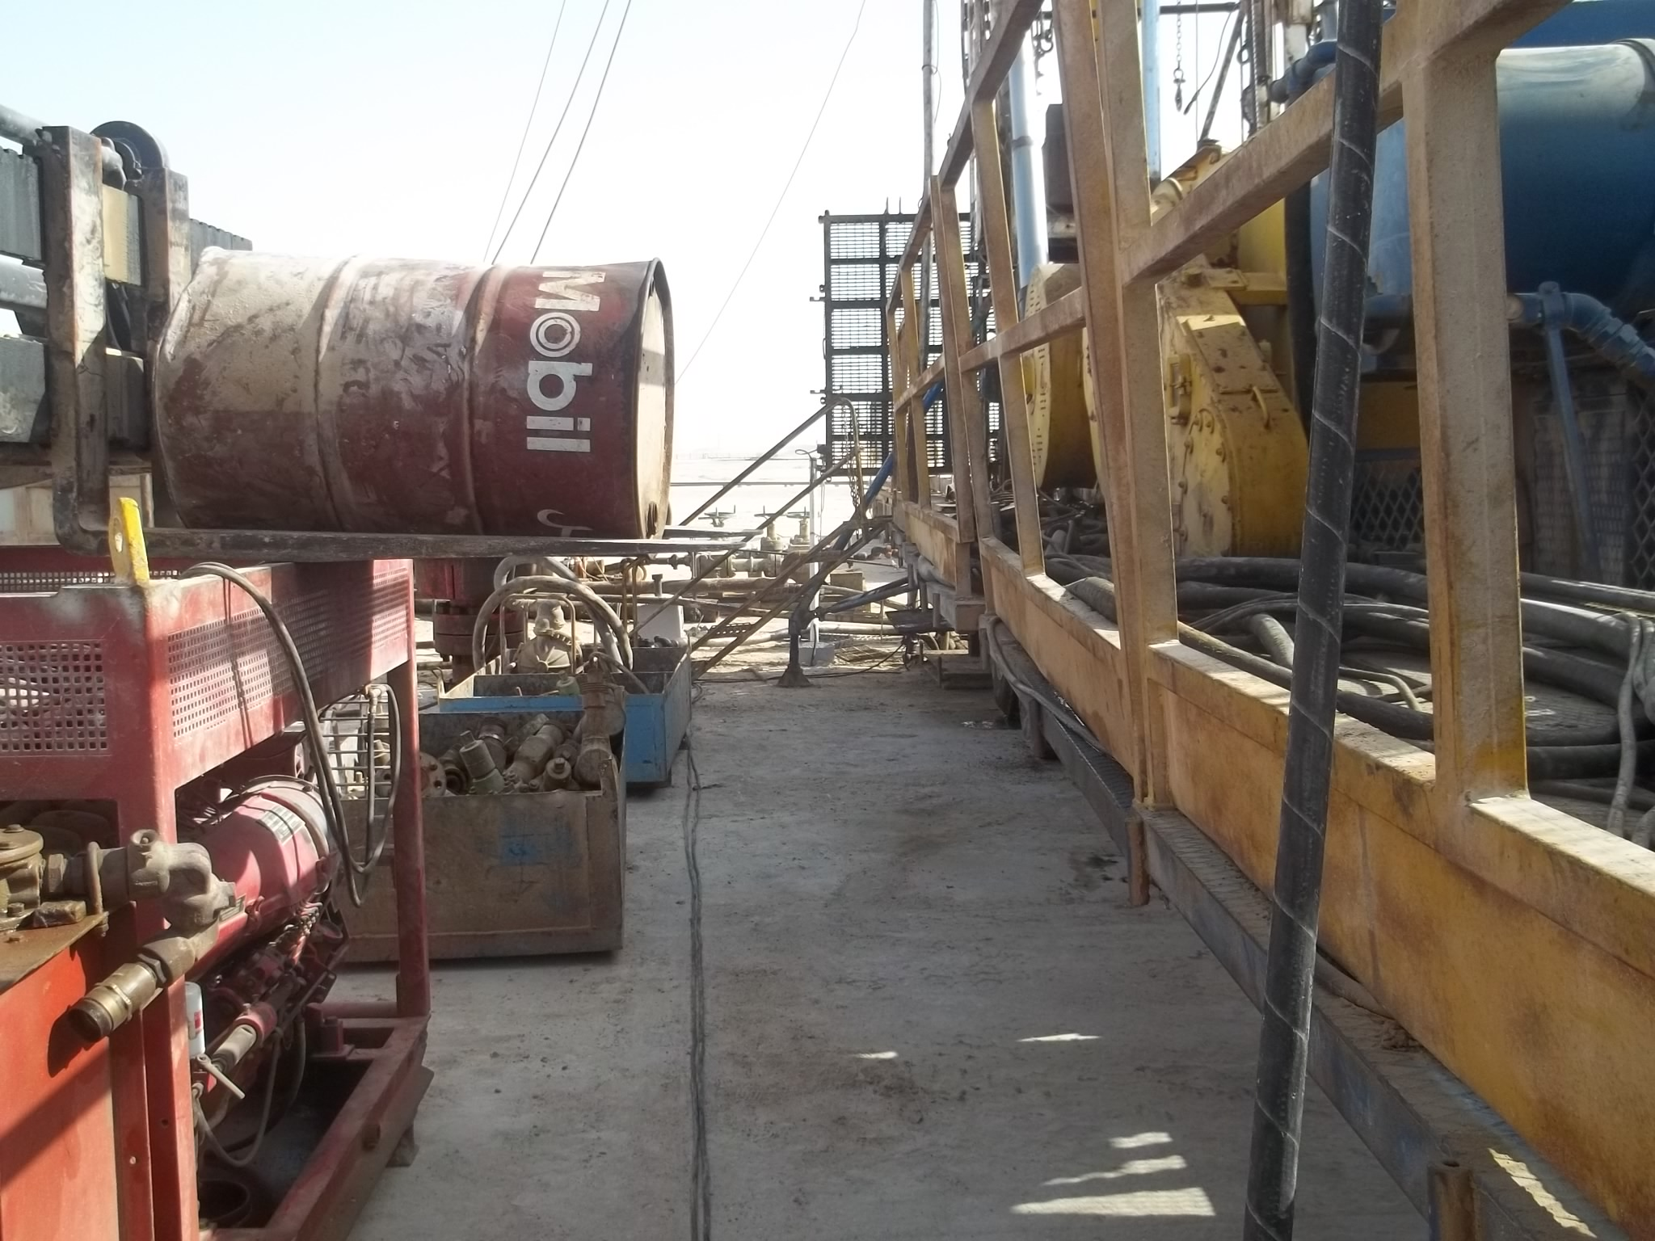


PDO Incident First Alert
Incident type | LTI(#21) | PIM ID | 1089732
Date/ time | 29/05/2015 (08:30 hrs) | Directorate
Location | Sayyalah | Dept
What happened
While trying to fill the hoist diesel tank from a diesel drum on a forklift forks the mechanic climbed over the barrier standing with one foot on the forks and the other on the hoist. As he tried to roll the drum he felt dizzy and fell 1.2m to the ground dislocating his right knee.
Mr. Musleh asks the questions of can it happen to you?
Do you always stand where you are safe from falling?
Do you plan the job beforehand to avoid a dangerous activity?
If a repetitive job is difficult do you review how it can be done better?
Do you known the correct way the work should be done?
Mechanic was standing with one leg on the fork & one on the hiost while handling the drum
Please disseminate this LTI notification to your teams and use it in your tool box talks and HSE meetings and notice boards.

