Slide 1

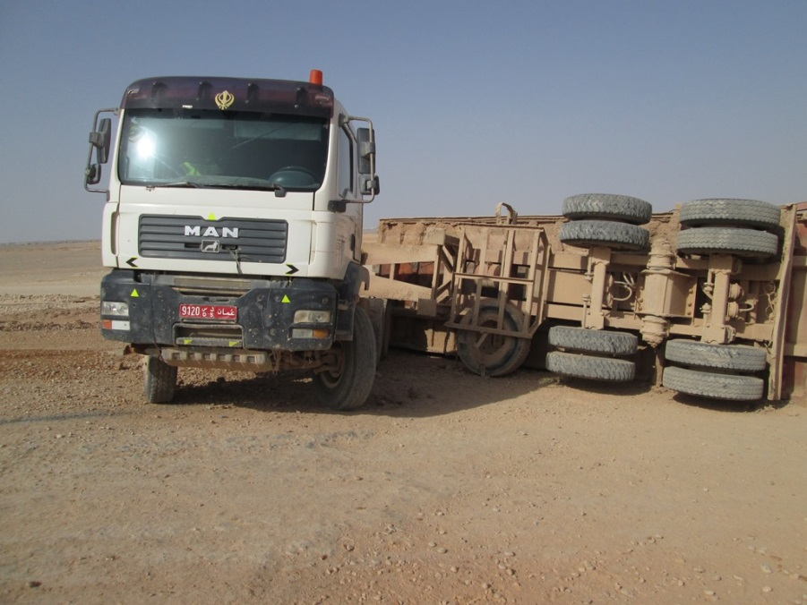
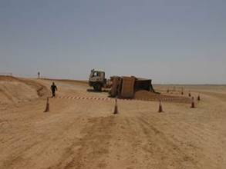
PDO Safety Advice
Use this Advice: Discuss in Tool Box Talks and HSE Meetings ➔ Distribute to contractors ➔ Post on HSE Notice Boards ➔ Include in site HSE Induction
  Date: 06/03/2015
  Injury: Fractured pelvic
What happened?
A tipper driver driving an articulated tipper truck laden with sand took a short cut up a steep ramp. He was forced to brake when he missed his gear and the trailer rolled back down the ramp and overturned causing the cab to lift off the ground. The cab dropped back to the ground with force. The impact fractured the drivers pelvis.
Your learning from this incident….
Short-cuts are the nearest route to injuries
Follow site rules and regulations. They are implemented for safety of all
Don’t take short cuts, always follow the site safety rules
Contact MSE34 for further information Learning No 11 06/03/2015

Slide 2
Management learning's
Distribute to contractors ➔ Post on HSE Notice Boards
  Date: 06/03/2015
  Injury: Fractured pelvic
As a learning from this incident and ensure continual improvement all contract
managers are to review their HSE HEMP against the questions asked below
Confirm the following:
Is there adequate signage for traffic routes on site?
Is there a one-way traffic scheme included in HEMP for on-plot site works?
Does the HEMP clearly identify the risks of failing to use the approved traffic routes?
Is the transportation HEMP cascaded to all drivers including LCC’s?
Learning No 11 06/03/2015

