Slide 1

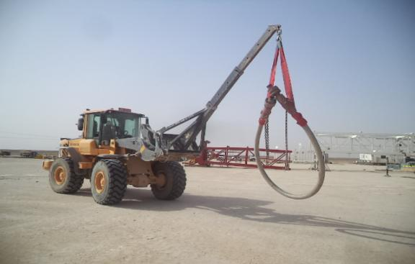

PDO Safety Advice
Use this Advice: Discuss in Tool Box Talks and HSE Meetings ➔ Distribute to contractors ➔ Post on HSE Notice Boards ➔ Include in site HSE Induction
  Date: 17/03/2015
  Injury: Fractured toes
What happened?
Trainee AD connected the two ends of the 6 meter long hose to the two-leg chain hooked-up to the forklift boom, using the safety clamps eyes as points of attachment. As the hose was being lowered, the hook worked its way out of the eye resulting in the hose flexing out diagonally and struck the trainees right foot fracturing his toes.
Your learning from this incident...
Lifting of flexing hose requires a lifting plan, JSA and TRIC. In case soft slings are used, a PTW should be issued.
Never stand near the load during picking up, travelling or lowering of the load.
If you are not sure how to lift a load, ask the advice of your supervisor.
Never tip-load, back-load or side-load a hook.
Always intervene if you have any doubt .
Always maintain a safe distance from a suspended load.
Always ensure the correct lifting method is applied.
Contact MSE34 for further information Learning No 13 17/03/2015

Slide 2
Management learning's
Distribute to contractors ➔ Post on HSE Notice Boards
  Date: 17/03/2015
  Injury : Fractured toes
As a learning from this incident and ensure continual improvement all contract
managers are to review their HSE HEMP against the questions asked below:
Confirm the following:
Is your team trained and competent in lifting, rigging and banksman skills?
Is your team competent enough to design and carry out lift Plans?
Have you launched training regarding dynamic DROPS?
Learning No 13 17/03/2015

