Slide 1
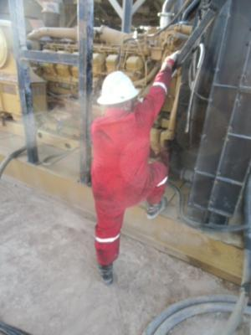
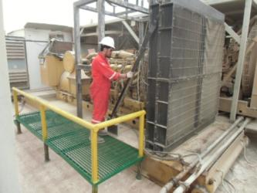
PDO Safety Advice
Use this Advice: Discuss in Tool Box Talks and HSE Meetings ➔ Distribute to contractors ➔ Post on HSE Notice Boards ➔ Include in site HSE Induction
Date: 31/03/2015
Injury: Fractured hand
What happened?
Chief Mechanic was doing routine inspection on Back Up Engine, he put his right foot on the skid 40 cm above ground and holding his right hand on the cross bar. He lost his grip falling to the ground landing on his left hand fracturing his left wrist.
Your learning from this incident..
Plan the work and think of potential hazard
Don’t take short cuts
Stand in proper place while doing tasks
IF YOU ARE NOT SUPPOSE TO STAND THERE…THEN DON’T
Contact MSE34 for further information Learning No 14 31/03/2015

Slide 2
Management learning's
Distribute to contractors ➔ Post on HSE Notice Boards
Date: 31/03/2015
Injury: Fractured hand
As a learning from this incident and ensure continual improvement all contract
managers are to review their HSE HEMP against the questions asked below
Confirm the following:
Do you have a system in place to monitor new equipment/material received at work site?
Management to ensure that MOC process is followed at all times
Does this same system capture the installation of Capital Spare Equipment on your rig?
Do you ensure safe access and egress?
Learning No 14 31/03/2015

