Slide 1
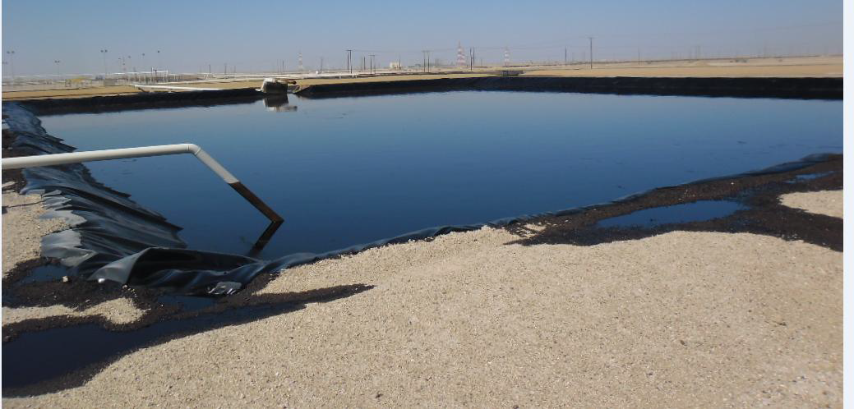
PDO Safety Advice
Use this Advice: Discuss in Tool Box Talks and HSE Meetings ➔ Distribute to contractors ➔ Post on HSE Notice Boards ➔ Include in site HSE Induction
Date: 15/02/2015
Tier 1: Relief pit overflow
What happened
Relief pit overflowed and compromised bund integrity, released gross liquid to environment.
Learnings from this incident..
Review all alarms which are prioritised low on safety critical equipment (SCE)
Review all modular projects in compliance with DCAF and GU-611
Ensure DEP is minimal for all projects, verify this is sufficient to your project requirements
Capture and investigate for all operational upsets / instances outside defined operating envelope
Ensure low priority alarms are reviewed on SCE
Contact MSE34 for further information Learning No 16 15/02/2015

Slide 2
Management learning's
Distribute to contractors ➔ Post on HSE Notice Boards
Date: 15/02/2015
Tier 1: Relief pit overflow
As a learning from this incident and ensure continual improvement all contract
managers are to review their HSE HEMP against the questions asked below
Confirm the following:
Do your engineering teams review and comply within the project scope?
Does all the safety critical equipment (SCE) categorised within high alarm levels require operational intervention?
Is compliance to DEP sufficient?
Do you analyse all operational upsets and capture deficiencies / lessons against defined envelope?
Have you cascaded the above lessons to your peers?
Learning No 16 15/02/2015

