Slide 1
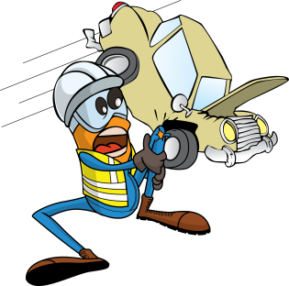
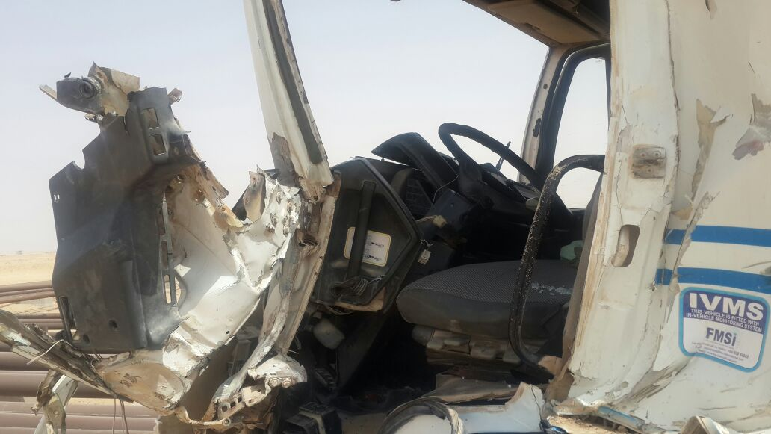
PDO Incident First Alert
Incident type | LTI(#22) | PIM ID | 1089857
Date/ time | 10/06/2015 (08:25 hrs) | Directorate
Location | Dhihab/Marmul area | Dept
What happened
A heavy vehicle was travelling on a graded road when it collided with the rear of another trailer causing serious injury to the driver and extensive damage to the vehicle.
Mr. Musleh asks the questions of can it happen to you?
Do you stay out of a dust cloud when driving?
Do you always give the road your full attention?
Do you keep a safe distance behind the vehicle in front?
Are you sure your brakes are in good condition?
Do you ensure you are well enough to be driving?
Please disseminate this LTI notification to your teams and use it in your tool box talks and HSE meetings and notice boards.

