Slide 1
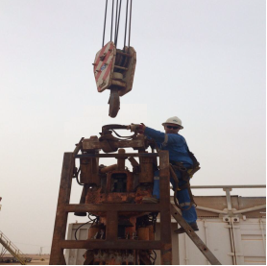
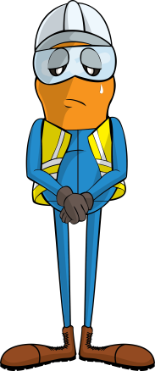
PDO Incident First Alert
Incident type | LTI(#23) | PIM ID | 1089899
Date/ time | 11/06/2015 (11:45 hrs) | Directorate
Location | Ghadeer, Nimr | Dept
What happened
A crane had just lowered a Top Drive System down onto the ground. An engineer attempted to disconnect the Top Drives lifting loop (bail) from the cranes hook but it was stuck. To free it the crane driver lowered the hook further but when the loop became free it fell on the engineers arm and fractured it.
Mr. Musleh asks the questions of can it happen to you?
Do you always pay attention when conducting your work?
Do you ensure you are out of the “line of fire”?
Loop (bail)
Please disseminate this LTI notification to your teams and use it in your tool box talks and HSE meetings and notice boards.

