Slide 1
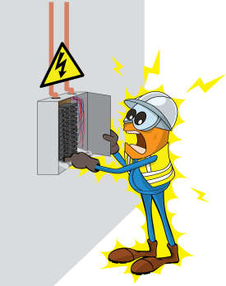
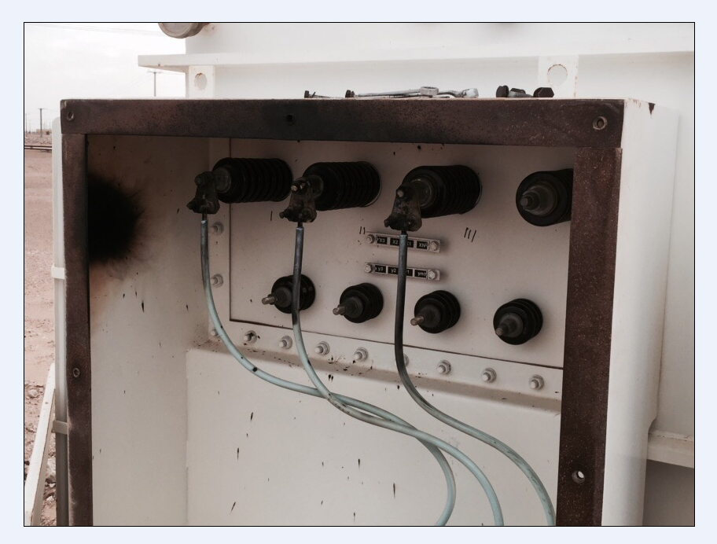
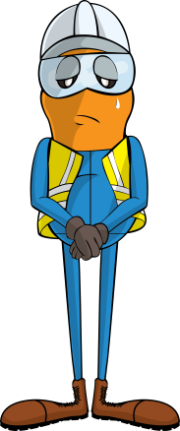

PDO Incident First Alert
Incident type | LTI(#24) | PIM ID | 1089903
Date/ time | 13/06/2015 (10:45 hrs) | Directorate
Location | Qarn Alam | Dept
What happened
An electrician received an electric shock resulting in burns to his upper body, face and neck after he opened up a transformer cover to change a fuse without first isolating the power.
Mr. Musleh asks the questions of can it happen to you?
Do you know if the power requires isolation?
Do you have a valid permit to work?
Do you ensure the power source is isolated?
Please disseminate this LTI notification to your teams and use it in your tool box talks and HSE meetings and notice boards.

