Slide 1

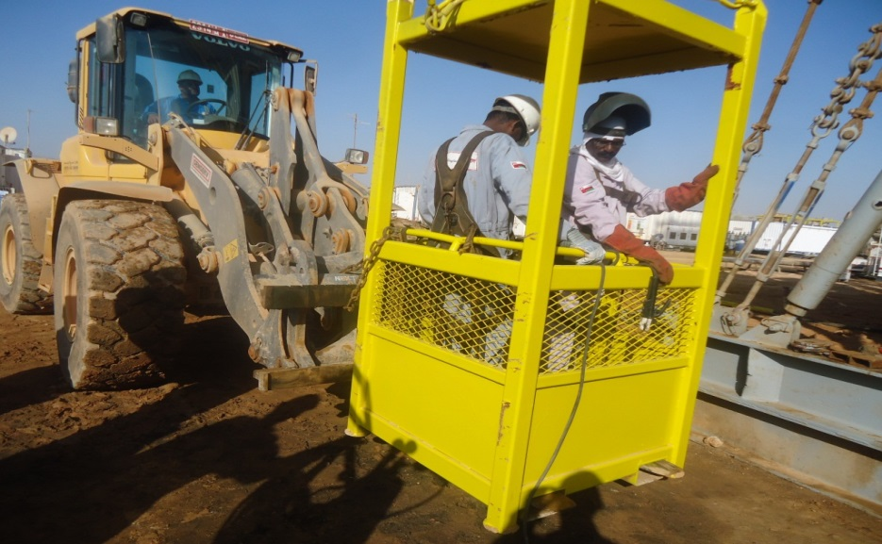
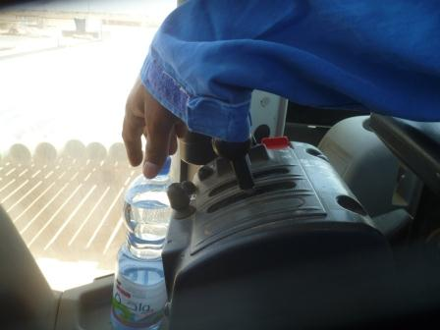
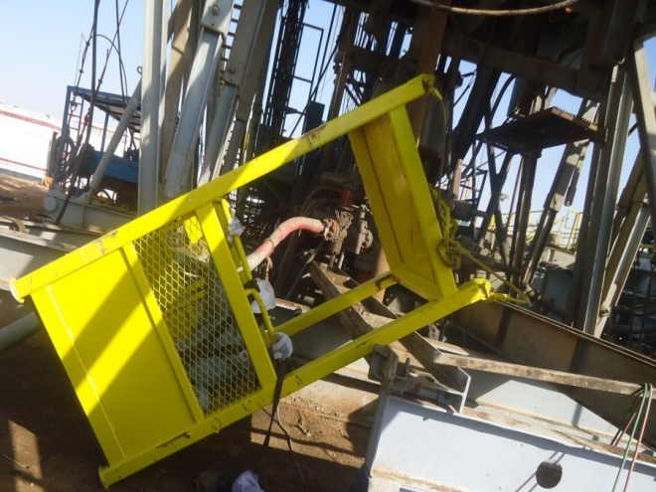
Safety Alert
Use this Alert: Discuss in Tool Box Talks and HSE Meetings ➔ Distribute to contractors ➔ Post on HSE Notice Boards ➔ Include in site HSE Induction
Loose clothing hazard
A wheel loader was being used with a fork attachment to lift two welders in a man basket to work at a height of 3m. As the operator reached for his water bottle he caught his sleeve on the forks control lever causing the forks to tilt and the man basket and men to fall to the ground. They were very lucky not to be crushed and killed.

Slide 2

Safety Alert
Mr. Musleh asks the questions of can it happen to you?
Do you ensure when using machinery the Velcro on coverall sleeves is fastened tight?
Does your clothing fit correctly?
If you are sitting in plant or equipment on stand-by have you ensured the power is isolated?
Do you ensure equipment attachments are secure?

