Slide 1
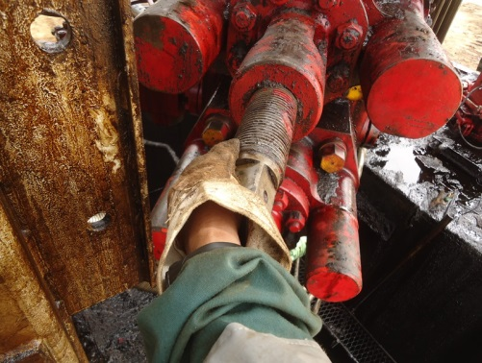
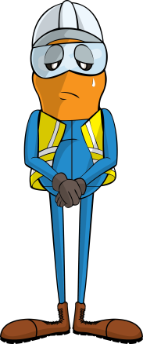
PDO Incident First Alert
Incident type | LTI (#25) | PIM ID | 1089955
Date/ time | 19/06/2015 (09:00 hrs) | Directorate
Location | Hoist 56 – Marmul area | Dept
BOP
What happened
A blow out preventer (BOP) suspended from a crane was being manually guided into position by an assistant driller. Whilst physically handling it the BOP swung sideways and trapped his finger against the rig mast fracturing it.
Mr. Musleh asks the questions of can it happen to you?
Do you keep your hands away from where they can be crushed?
Do you use tag lines when handling suspended loads?
Crush point
Please disseminate this LTI notification to your teams and use it in your tool box talks and HSE meetings and notice boards.

