Slide 1
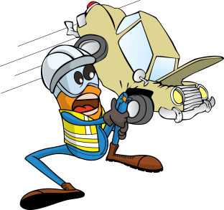
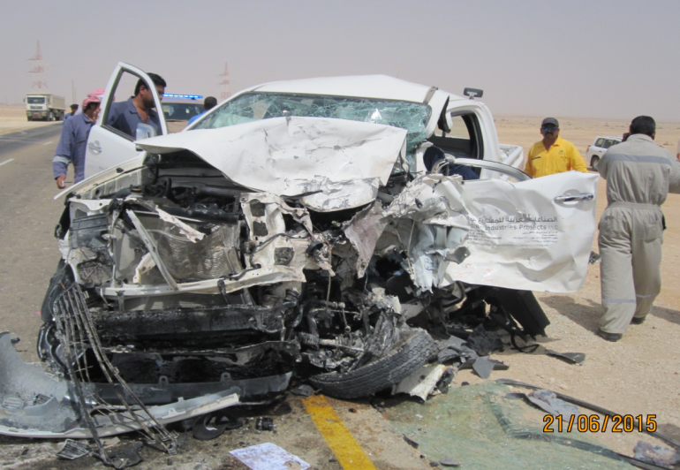
PDO Incident First Alert
Incident type | LTI (#26) | PIM ID | 1089990
Date/ time | 21/06/2015 (09:22 hrs) | Directorate
Location | Nimr - Marmul road | Dept
What happened
A pickup truck travelling from Nimr to Marmul and the 3 ton canter truck travelling in the opposite direction were involved in a head on collision 3km outside of Marmul. The pickup driver suffered multiple injuries and the other two (pickup passenger & canter driver) received first aid treatment.
Mr. Musleh asks the questions of can it happen to you?
Have you had sufficient rest before driving in Ramadhan?
Are you eating sensibly during Ramadhan?
If you feel tired are you sensible enough to stop and rest?
As a passenger are you keeping a watch to ensure the driver stays awake?
Please disseminate this LTI notification to your teams and use it in your tool box talks and HSE meetings and notice boards.

