Slide 1
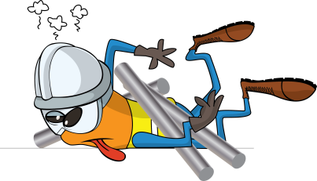
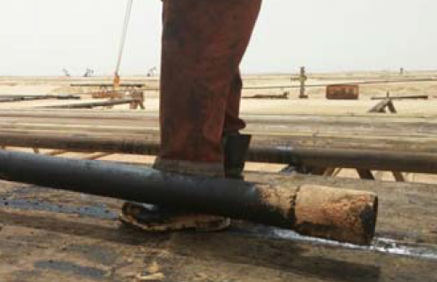
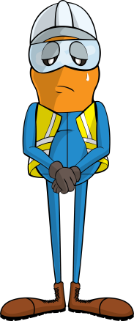
PDO Incident First Alert
Incident type | LTI (#27) | PIM ID | 1089988
Date/ time | 22/06/2015 (05:00 hrs) | Directorate
Location | South Amal | Dept
What happened
The Forklift Truck (FLT) Operator and Floor man were removing a pipe from the catwalk. As the FLT operator lifted the pipe, the Floor man tried to stop the pipe from rolling with his foot; the pipe slipped off the forks and dropped 60cm hitting his foot fracturing his left ankle.
Mr. Musleh asks the questions of can it happen to you?
Do you always stand outside of the lifting zone?
As a forklift operator do you ensure there is no-one inside your lifting zone?
Please disseminate this LTI notification to your teams and use it in your tool box talks and HSE meetings and notice boards.

