Slide 1
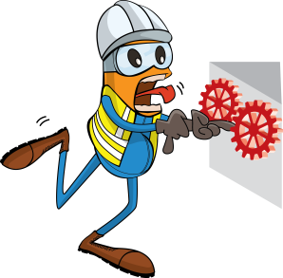
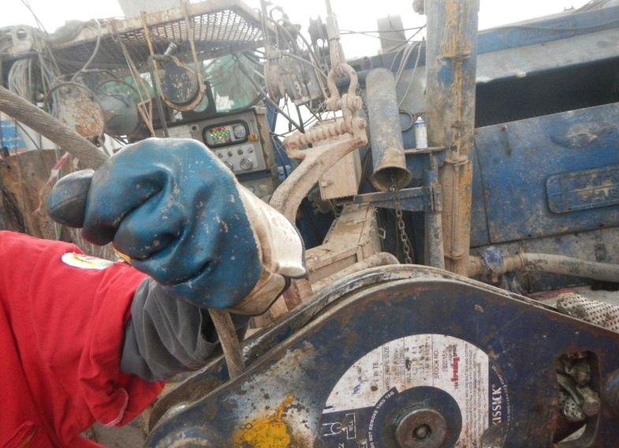
PDO Incident First Alert
Incident type | LTI (#28) | PIM ID | 1090015
Date/ time | 23/06/2015 (15:55 hrs) | Directorate
Location | Sakhyah, Harweel | Dept
What happened
A logging engineer was feeding a slack cable into a clamp on a logging unit. The clamp however failed which caused the cable under 5000lbs of tension to slip through the clamp pulling his fingers into the mechanism and severed off three of his fingers.
Mr. Musleh asks the questions of can it happen to you?
Do you always keep your hands/fingers are away from crush points?
Have you checked your clamping equipment is regularly maintained and tested ?
Please disseminate this LTI notification to your teams and use it in your tool box talks and HSE meetings and notice boards.

