Slide 1
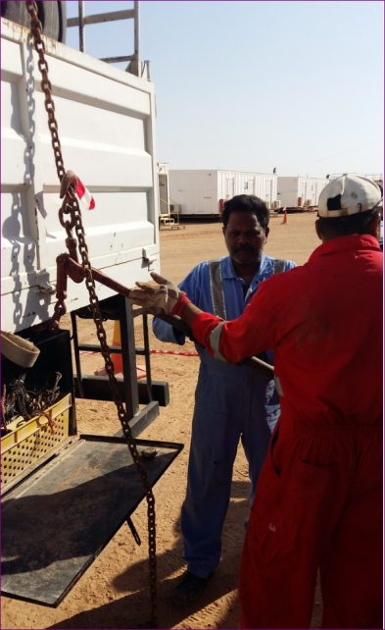
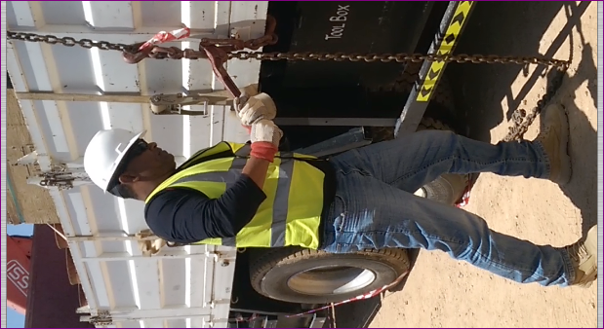
PDO Safety Advice
Use this Advice: Discuss in Tool Box Talks and HSE Meetings ➔ Distribute to contractors ➔ Post on HSE Notice Boards
Date: 16/04/2015
LTI: driver struck in face by chain binder lever
What happened
Two contractors were securing a large tyre in a cargo truck using a lever chain binder and a cheater bar, when the cheater bar came off the lever. The tension in the lever binder was released and the lever flew up striking one of the contractors in the face damaging his eye.
Learnings from this incident..
Wherever possible, use ratchet chain binders instead of lever chain binders.
Avoid cheater bars when using lever chain binders.
If you must use a lever chain binder and a cheater bar, only one person should use it, ensure you are properly trained and stay out of the line of fire.
Avoid using cheater bars with lever chain binders
Contact MSE34 for further information Learning No 19 16/04/2015

Slide 2
Management learning's
Distribute to contractors ➔ Post on HSE Notice Boards
Date: 16/04/2015
LTI: driver struck in face by chain binder lever
As a learning from this incident and ensure continual improvement all contract
managers are to review their HSE HEMP against the questions asked below
Confirm the following:
Do your staff have the correct equipment available for the task?
Have all medium and high risk tasks, even if non routine, have a JSA?
Are all hazards identified in the HEMP?
Learning No 19 16/04/2015

