Slide 1
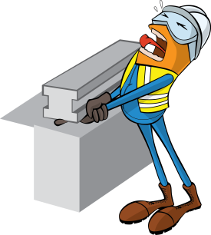
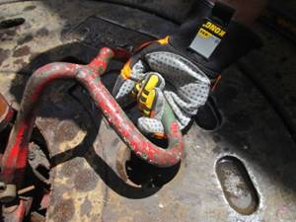
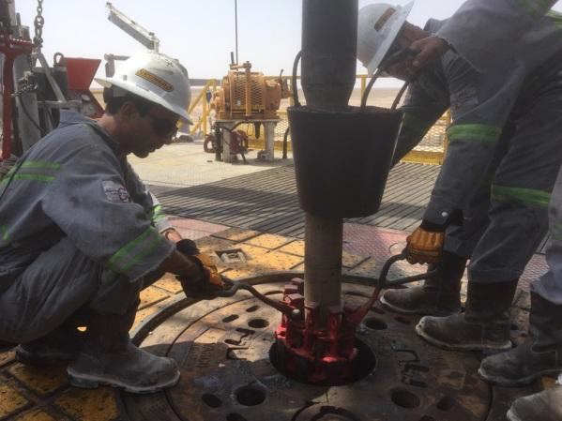
PDO Safety Advice
Use this Advice: Discuss in Tool Box Talks and HSE Meetings ➔ Distribute to contractors ➔ Post on HSE Notice Boards
Date: 11/04/2015
LTI: Nipped Finger under slips handle
What happened
The operation was Running In Hole with 6 1/2" drill collars. While setting the slips, the IP was holding the rear slips handle, which on lowering came in contact with the steel toe tap of his boot. This caused his right hand middle finger to be nipped between his boot toe cap and the bottom part of the handle resulting in the amputation of his finger tip.
Learnings from this incident..
3rd Party Certification for a slip handle, just means that it is crack free.
It does not mean that the handle is the correct shape.
Correct body position for setting the slips would have prevented this incident.
By installing rubberised handles on all slips will prevent reoccurrence
Inspect equipment prior to use
Contact MSE34 for further information Learning No 18 11/04/2015

Slide 2
Management learning's
Distribute to contractors ➔ Post on HSE Notice Boards
Date: 11/04/2015
LTI: Nipped Finger under slips handle
As a learning from this incident and ensure continual improvement all contract
managers are to review their HSE HEMP against the questions asked below
Confirm the following:
Has all information been accurately communicated to workers involved in all activities?
Have appropriate audits and checks been conducted, conducted properly and have hazards identified been rectified in a timely manner?
Are Hazard Hunts being carried out regularly at both rig sites and have hazards identified been rectified in a timely manner?
Learning No 18 11/04/2015

