Slide 1
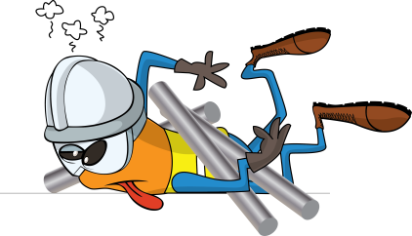

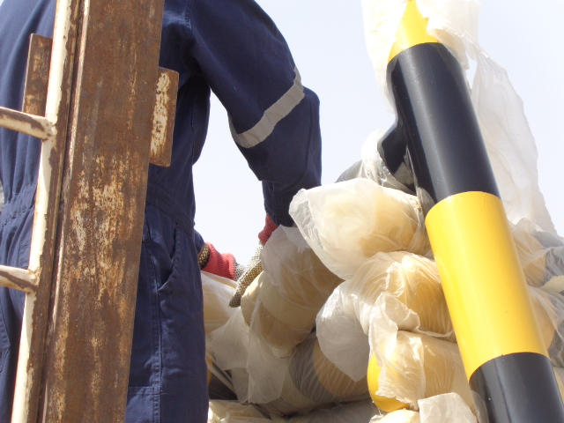
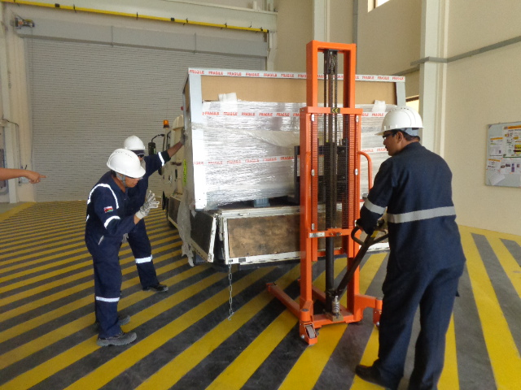

PDO Safety Advice
Use this Advice: Discuss in Tool Box Talks and HSE Meetings ➔ Distribute to contractors ➔ Post on HSE Notice Boards
Date: 11/04/2015
LTI: fractured thumb injury
What happened
A worker made the decision to unload steel pipe (T-Shaped) from a flat bed trailer manually without receiving a toolbox talk prior to the task, supervision failed to brief the safe method of work or stop to the employee.
As the worker moved a steel pipe it became unstable, the pipe rotated around the horizontal section trapping the his thumb in the process against another pipe causing a deep cut and fracture of his thumb.
Learnings from this incident..
All deliveries must have a delivery plan, the plan must be briefed at the work location to all those involved in the activity
No heavy items may be unloaded by hand, mechanical aids must be used
No worker may make the decision to manually unload a delivery vehicle, this requirement must be specified in the delivery plan
If it a mechanical aid is unavailable and it is unsafe to unload by hand the task must be stopped until a mechanical aid is available, if a mechanical aid is not available the delivery must be returned to the supplier.
Never unload heavy loads by hand
Contact MSE34 for further information Learning No 21 11/04/2015

Slide 2
Management learning's
Distribute to contractors ➔ Post on HSE Notice Boards
Date: 11/04/2015
LTI: fractured thumb injury
As a learning from this incident and ensure continual improvement all contract
managers are to review their HSE HEMP against the questions asked below
Confirm the following:
Are deliveries planned?
Have you provided mechanical handling equipment for heavy loads?
Do you encourage your employees to exercise “Empowerment to STOP Unsafe Work”?
Learning No 21 11/04/2015

