Slide 1
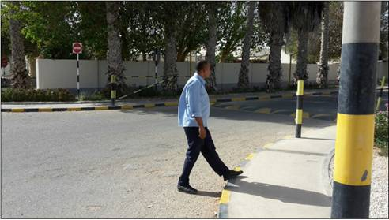
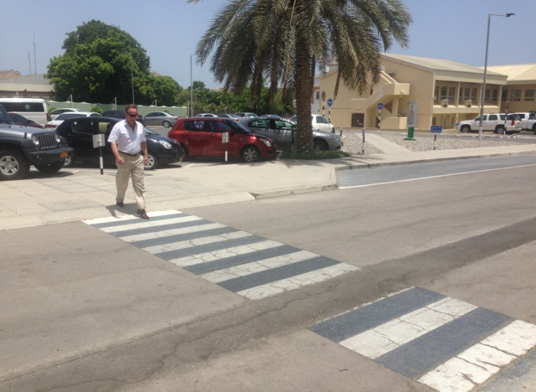
PDO Safety Advice
Use this Advice: Discuss in Tool Box Talks and HSE Meetings ➔ Distribute to contractors ➔ Post on HSE Notice Boards
Date: 08/04/2015
LTI: fractured shins
What happened
Whilst crossing a roadway the camp boss stumbled when stepping on to the pavement and fell heavily with his shin falling onto the kerb stone. He fractured both his shin bones as a result.
Learnings from this incident..
Always use pedestrian crossings where provided?
Always take care when stepping up or down?
Ensure you wear the correct footwear?
Avoid walking while distracted on the phone?
Always observe safe pedestrian zones
Contact MSE34 for further information Learning No 22 08/04/2015

Slide 2
Management learning's
Distribute to contractors ➔ Post on HSE Notice Boards
Date: 08/04/2015
LTI: fractured shins
As a learning from this incident and ensure continual improvement all contract
managers are to review their HSE HEMP against the questions asked below
Confirm the following:
Are walkways clearly marked?
Are walkways maintained and in good condition?
Do you encourage your employees to use pedestrian crossings?
Learning No 22 08/04/2015

