Slide 1
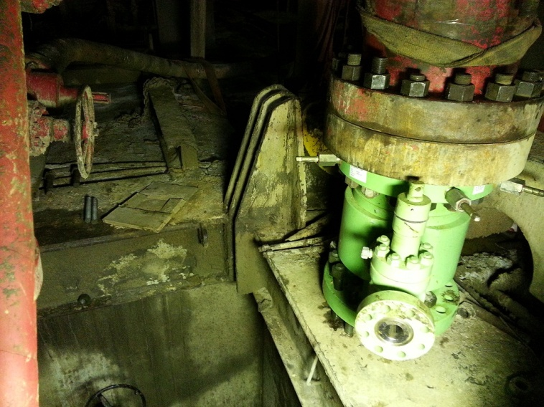
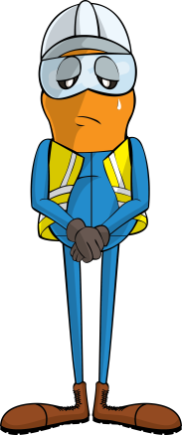
PDO Incident First Alert
Incident type | LTI (#29) | PIM ID | 1090044
Date/ time | 27/06/2015 (20:00 hrs) | Directorate
Location | Fahud | Dept
What happened
As a forklift placed a tubing head spool down on uneven floor it began to topple over towards the rig cellar. The driller tried to stop it and in doing so his hand was crushed between the spool and an upright part of the rig structure, fracturing two fingers.
Structure which trapped his hand
Mr. Musleh asks the questions of can it happen to you?
Direction it toppled
Do you ensure a flat stable surface before placing loads?
Do you use tag lines to guide loads?
Are you always aware of where your fingers could be crushed?
Tubing Head Spool
Please disseminate this LTI notification to your teams and use it in your tool box talks and HSE meetings and notice boards.

