Slide 1
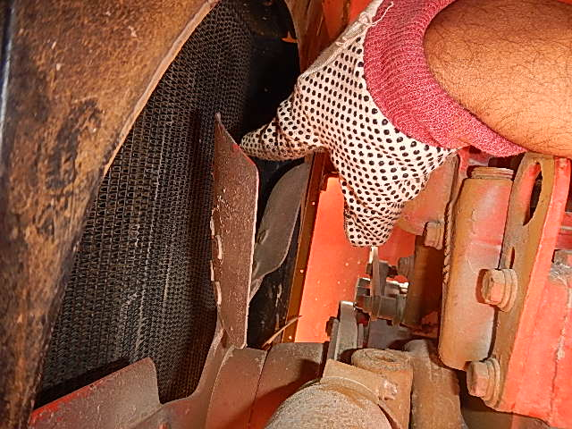
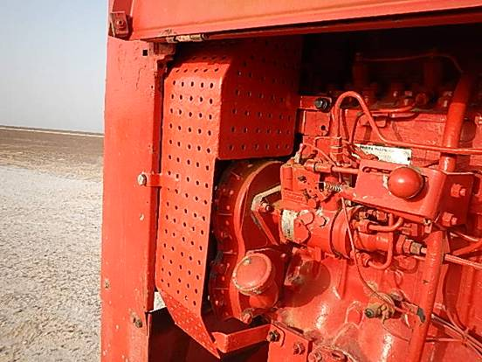
PDO Safety Advice
Use this Advice: Discuss in Tool Box Talks and HSE Meetings ➔ Distribute to contractors ➔ Post on HSE Notice Boards
Date: 04/04/2015
Injury: Fractured finger
What happened
A Welder observed a leak in the radiator of the welding machine engine which was running. While showing the leak to the Tool Pusher by pointing, his right hand index finger came into contact with the radiator fan resulting in his finger getting trapped between the radiator and the fan causing a fracture to his right index finger.
Learnings from this incident..
Isolation should be done before working on machinery
Do not place hand/fingers in or near moving parts
Apply the empowerment to STOP when the job is unsafe
Use HANDS OFF technique where possible
Keep away hands away from rotary equipment
Contact MSE34 for further information Learning No 15 04/04/2015

Slide 2
Management learning's
Distribute to contractors ➔ Post on HSE Notice Boards
Date: 04/04/2015
Injury: Fractured finger
As a learning from this incident and ensure continual improvement all contract
managers are to review their HSE HEMP against the questions asked below
Confirm the following:
Do you have isolation procedure in place?
Do you ensure all moving parts have adequate guarding?
Do you ensure proper supervision?
Do you encourage your employees to exercise “Empowerment to STOP Unsafe Work”?
Learning No 15 04/04/2015

