Slide 1
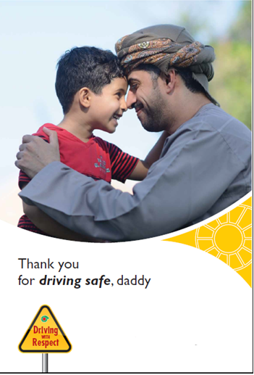
Be Safe during Eid Holidays
You are responsible for their smile!

Slide 2
You deserve Eid enjoyment
The Eid celebration is about
having great times with family & friends which can be achieved by
proper and safe planning for Eid activities, and safe driving behaviors on roads

Slide 3
Safe driving behaviours
Getting adequate rest prior to any trip to avoid fatigue.
Performing a vehicle pre-trip inspection (tyre, lubricants, coolant, belts, battery, lightning…etc).
Wearing a seat belt and ensuring passengers do so.
Complying with safe driving speed limits.
Stopping vehicle if using a mobile phone.
Keeping a safe distance from the vehicle in front on the road.
Remaining alert and respecting other road users.

Slide 4
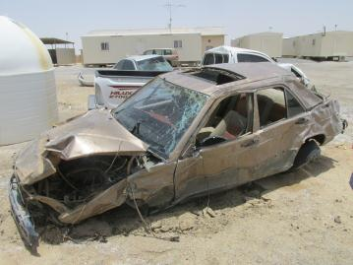
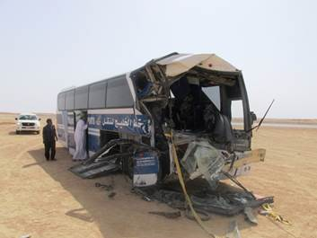
Eid accidents main factors
Speeding & not paying attention
Tiredness and Fatigue
Learn from others mistakes and do not repeat them
Take sufficient rest and be careful while driving for your own safety as well as other road users
Speeding

Slide 5
Remember that..
Your own driving behaviour
is the
most important factor
that influences your risk management
on the road.

