Slide 1
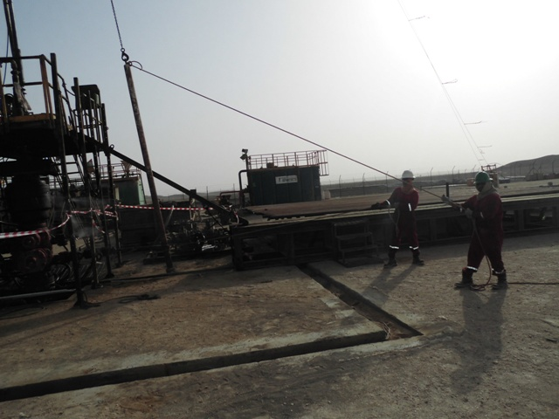
PDO Safety Advice
Use this Advice: Discuss in Tool Box Talks and HSE Meetings ➔ Distribute to contractors ➔ Post on HSE Notice Boards
Date: 06/05/2015
LTI: fractured finger
What happened
A supporting leg was being moved from the catwalk to the hoist floor was using hoist winch. The Derrickman decided to hold on supporting leg by pulling it towards the floor side and his right hand ring finger got trapped between the leg base and the catwalk resulting in a fracture to the finger tip.
Learnings from this incident..
Ensure hazards are identified for each activity and explained to crew members to prevent such an incident
Report any injury regardless of how minor you think it is
Always keep your fingers away from pinch points
Contact MSE34 for further information Learning No 24 06/05/2015

Slide 2
Management learning's
Distribute to contractors ➔ Post on HSE Notice Boards
Date: 06/05/2015
LTI: fractured finger
As a learning from this incident and ensure continual improvement all contract
managers are to review their HSE HEMP against the questions asked below
Confirm the following:
Does your standards/ procedures address the handling of Supporting leg of the work floor?
Is there a clear method of communication during Rig-up operation?
Does your HEMP address hazards and ergonomics? Are there any standards that you adhere to?
Learning No 24 06/05/2015

