Slide 1
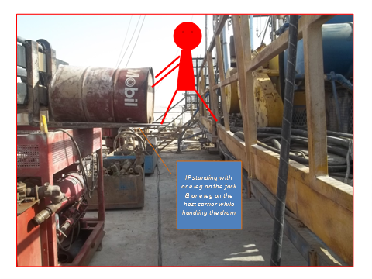
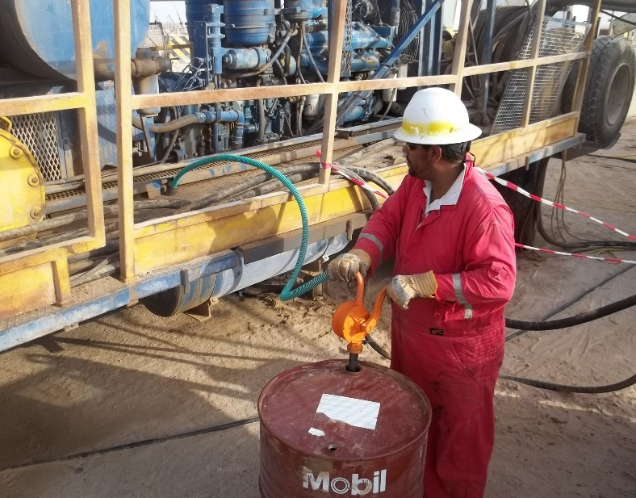
PDO Safety Advice
Use this Advice: Discuss in Tool Box Talks and HSE Meetings ➔ Distribute to contractors ➔ Post on HSE Notice Boards
Date: 29/05/2015
LTI: Injured knee
What happened?
The mechanic was trying to fill the diesel from a drum into the hoist’s diesel tank. He decided to come out of the hoist carrier fence stepping on the fork in order to adjust the drum that was held by forklift. Whilst adjusting the drum he lost his balance and fell down to the ground from a height of approx. 1.2m.
Your learning from this incident..
Always exercise the right of empowerment to stop an unsafe act
Ensure availability of the right tool for the task
Recognize the non routine activity and manage change accordingly
Use Fuel transfer pump for transferring diesel
Contact MSE34 for further information Learning No 27 29/05/2015

Slide 2
Management learning's
Distribute to contractors ➔ Post on HSE Notice Boards
Date: 29/05/2015
LTI: Injured knee
As a learning from this incident and ensure continual improvement all contract
managers are to review their HSE HEMP against the questions asked below
Confirm the following:
Do you have all necessary equipment on site to carry out task on safest way?
Does your procedures recommend how to do task in different way?
Are staff aware of their empowerment to stop unsafe acts?
Learning No 27 29/05/2015

