Slide 1
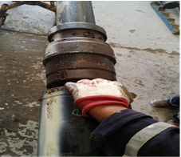
PDO Incident First Alert
Incident type | LTI (#30) | PIM ID | 1090500
Date/ time | 05/08/2015 (04:15 hrs) | Directorate
Location | Rig 45 | Dept
What happened
Whilst filling a liner hanger with polymer the engineer loosened the locking screws on the junk cover, lifted it and then re-locked it. An operator had placed his finger in a pinch point under the junk cover so the engineer demonstrated the risk to him by showing him what might have happened and at that moment the junk cover dropped and crushed his finger
Trapping point for fingers
Mr. Musleh asks the questions of can it happen to you?
Do you keep your fingers out of pinch points?
Do you use TBT material to educate rather than putting yourself at risk?
Do you always control your work-zone to keep others safe?
Junk cover
Please disseminate this LTI notification to your teams and use it in your tool box talks and HSE meetings and notice boards.

