Slide 1
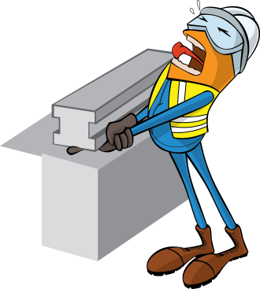
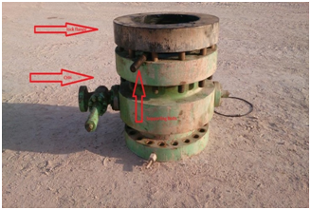
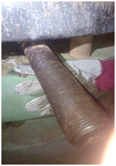


PDO Incident First Alert
Incident type | LTI (#31) | PIM ID | 1090540
Date/ time | 09/08/2015 (01:50 hrs) | Directorate
Location | Rig 54 | Dept
What happened
Instead of waiting for the forklift an assistant driller tried to release some jammed slips from inside the lock wellhead by hammering a bolt between the wellhead flange. As the slips released they dropped causing the flange to drop onto the bolt trapping his right hand index finger between the bolt & flange.
Well head
Mr. Musleh asks the questions of can it happen to you?
Bolt he was hammering
Do you keep your fingers out of pinch points?
Do you always think “What if?”?
Do you always wait for the right tools and people to do the job?
Crush point
Please disseminate this LTI notification to your teams and use it in your tool box talks and HSE meetings and notice boards.

