Slide 1
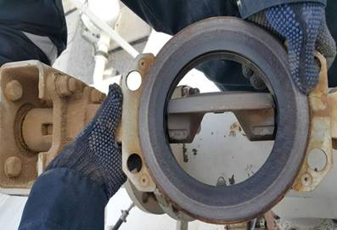
PDO Incident First Alert
Incident type | LTI (#32) | PIM ID | 1090549
Date/ time | 11/08/2015 (16:40 hrs) | Directorate
Location | Saih Rawl pumping station | Dept
Open valve gate
What happened
A mechanic was testing the operation of a hydraulic valve and was repositioning the valve gate with his hand inside the valve mechanism. The control room operator with whom he had been coordinating by radio (to open and close the valve) accidently closed it amputating the mechanics finger tip.
Mr. Musleh asks the questions of can it happen to you?
Valve body
Do you keep your fingers out of the “line of fire”?
Do you ensure clear communication?
Do you ensure equipment is isolated?
Do you know when a PTW is needed?
Finger pinch point
Please disseminate this LTI notification to your teams and use it in your tool box talks and HSE meetings and notice boards.

