Slide 1
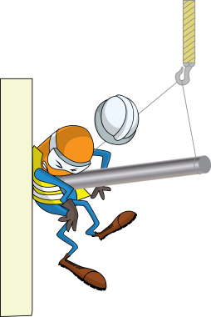
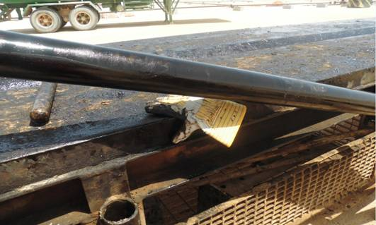
PDO Incident First Alert
Incident type | LTI (#33) | PIM ID | 1090580
Date/ time | 15/08/2015 (16:40 hrs) | Directorate
Location | Rig#41 Nimr | Dept
His hand
What happened
The rig crew were laying down tubing joints sliding them down the V door ramp using the cat line onto the hoist catwalk. The roustabout was standing next to the catwalk with his right hand resting on its edge and as a tubing joint came down the ramp it jumped out of the V groove and struck his hand fracturing a finger.
Mr. Musleh asks the questions of can it happen to you?
The tubing
Do you keep your fingers out of the “line of fire”?
Do you always pay attention when tubing is being slid down the ramp?
Do you always control the slide properly with the cat line to avoid bouncing?
The v groove the tubing should stay in
Please disseminate this LTI notification to your teams and use it in your tool box talks and HSE meetings and notice boards.

