Slide 1
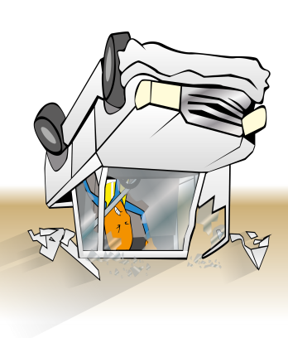
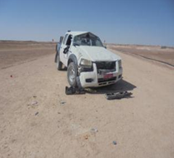
PDO Incident Road Safety Alert
Incident type | Rollover (#26)
Date/ time | 25-August-2015
Location | Qarn Alam
What happened
The driver of a PDO contractor pickup lost control and rolled the vehicle over whilst driving on a graded road. The seatbelt saved him from injury.
Mr. Musleh asks the questions of can it happen to you?
Do you drive if you are fatigued?
Do you keep your attention fully on the road?
Do you keep to the dust code?
Do you choose to wear your seatbelt?
Please disseminate this notification to your teams and use it in your tool box talks and HSE meetings and notice boards.

