Slide 1

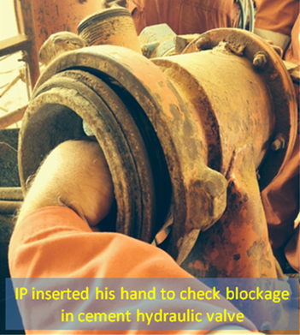


PDO Incident First Alert
Incident type | LTI (#35) | PIM ID | 1090709
Date/ time | 28/08/2015 (03:00 hrs) | Directorate
Location | Rig#81 Marmul | Dept
Outside of the valve
What happened
A rig crew were mixing cement in the mixing unit but found not much dry cement was flowing in via the cement suction line. They opened the line and a supervisor stuck his hand in to check the hydraulic valve was working. He asked for the valve to be switched on but as it was not stuck it closed trapping and fracturing his fingers.
Mr. Musleh asks the questions of can it happen to you?
Arm inside the line
Do you stick your hands where you can not see?
Do you assess how you can be injured when troubleshooting?
Is it best to look with a torch first before putting your fingers at risk?
Do you use tools to help keep your hands and fingers safe?
Please disseminate this LTI notification to your teams and use it in your tool box talks and HSE meetings and notice boards.

