Slide 1
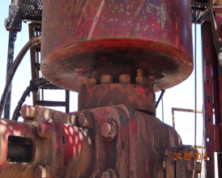
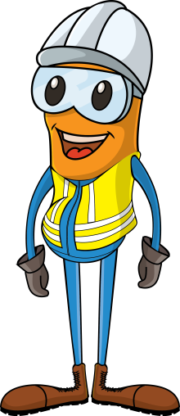
PDO Incident First Alert
Incident type | LTI (#36) | PIM ID | 1090724
Date/ time | 23/08/2015 (08:30 hrs) | Directorate
Location | Hoist #1 Nimr | Dept
BOP
What happened
A derrick man signaled a crane operator with his right hand to lower a part of the blow out preventer down on to a fixing. His left hand was resting on the bolts that the blow out preventer would drop onto and so as it was lowered it did so onto his hand crushing it against a studded bolt and fracturing his finger.
Mr. Musleh asks the questions of can it happen to you?
Studded bolt that crushed his finger
Do you keep your hand out of the line of fire?
Do you think how you might be injured during lifting operations?
Do you really think before you act?
If you are a crane driver do you always give your full attention?
Please disseminate this LTI notification to your teams and use it in your tool box talks and HSE meetings and notice boards.

