Slide 1
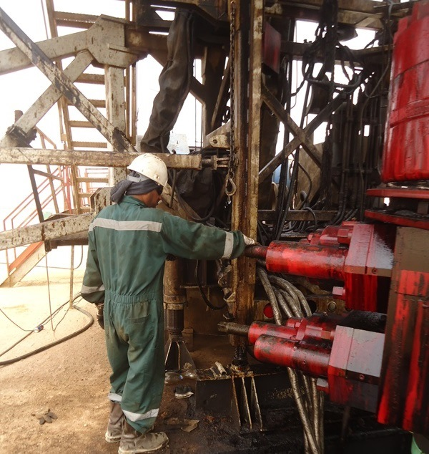
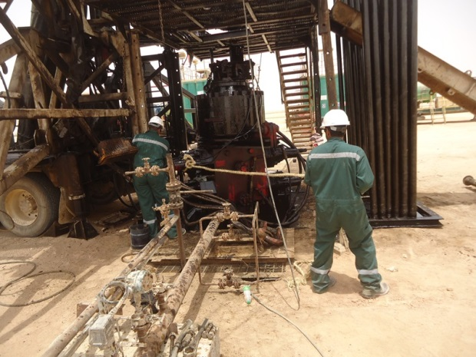
PDO Safety Advice
Use this Advice: Discuss in Tool Box Talks and HSE Meetings ➔ Distribute to contractors ➔ Post on HSE Notice Boards
Date: 19 June 2015.
LTI: Finger Crush Injury
What happened?
While performing BOP operation, the BOP swung and crushed the assistant drillers right hand between BOP ram and the mast.
Your learning from this incident..
Always keep your hand away from pinch points.
Use tagline for all lifting operations.
Follow JSA and SOP
Always apply “Empowerment to STOP unsafe work and intervene at unsafe act and condition”.
Hands off suspend loads “Use Tagline”
Contact MSE34 for further information Learning No 25 19/06/2015

Slide 2
Management learning's
Distribute to contractors ➔ Post on HSE Notice Boards
Date: 19 June 2015.
LTI: Finger Crush Injury
As a learning from this incident and ensure continual improvement all contract
managers are to review their HSE HEMP against the questions asked below
Confirm the following:
Have you ensured the SOP & JSA are covering all the jobs to be carried out?
Did the Operational Team aware of the latest SOP & JSA?
Do you encourage your employees to exercise “Empowerment to STOP Unsafe Work”?
Do you check the independent supervision for the critical task?
Learning No 25 19/06/2015

