Slide 1
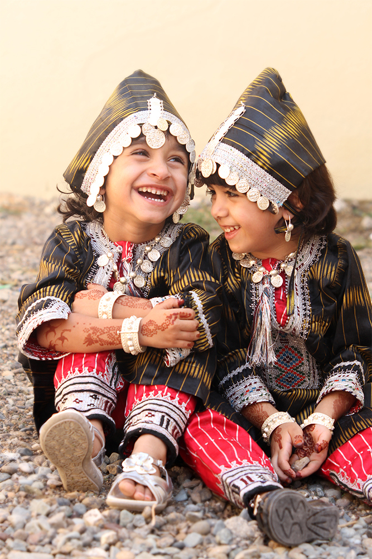
Safe driving during Eid Holidays
You are responsible for their smile

Slide 2
You deserve Eid enjoyment
Eid celebration is about having Great times with Family & friends which can be achieved by having proper safe planning for Eid activities and reflecting safe driving behaviors on roads.

Slide 3
Safe driving behaviors
Getting adequate rest prior any trip to avoid fatigue.
Performing vehicle pre trip inspection (Tyre, lubricants, coolant, belts, battery, lightning…etc).
Wearing safety belt and ensure passengers do so.
Complying with safe driving speed limits.
Stopping vehicle while using mobile phone.
keeping safe distance on the road.
Remain alerted and respecting other road users.

Slide 4
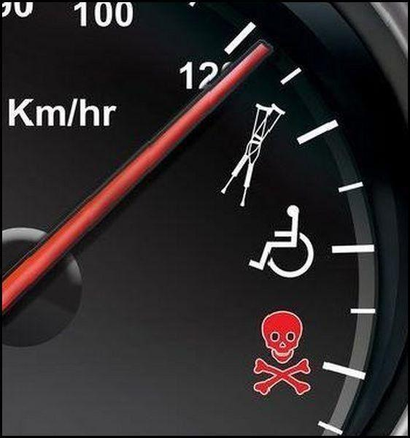
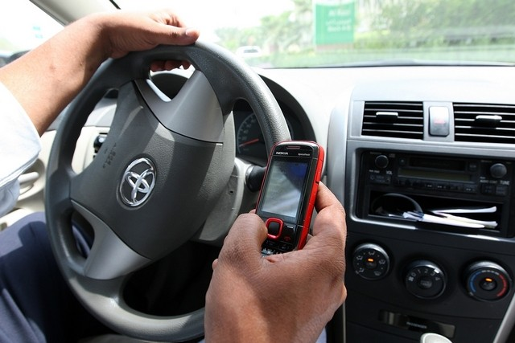
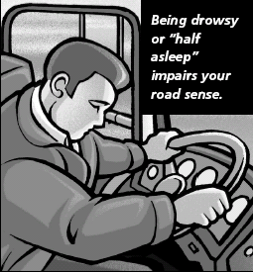
Eid accidents main factors
Excessive Speeding
Using Mobile phone
Fatigue
Speeding

Slide 5
Remember that..
Your own behavior
is the
most important factor
that influences your risk management
on the road.

