Slide 1

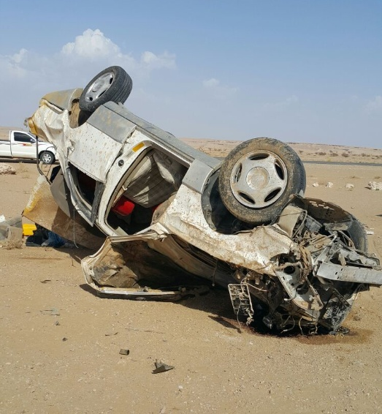

PDO Incident First Alert – (Private vehicle)
Incident type | Fatal Private Rollover (#4) | PIM ID | 1090839
Date/ time | 11/09/2015 (15:00hrs) | Directorate
Location | Ibri | Dept
What happened
Three contractor colleagues drove home to Ibri from Rahab in a private car driving extremely fast, nearly reaching Ibri over 700km away in less than 4 hours, (the ROP estimated the crash speed exceeded 180 km/hr). The driver swerved to avoid an obstacle in the road, he lost control, the car rolled over and he was ejected violently from the vehicle to his death. His two colleagues remained in the vehicle but suffered serious injuries including a fractured hip and leg. Our thoughts are with the family of the deceased and injured
Mr. Musleh asks the questions of can it happen to you?
Do you break the speed-limit when you drive your own private car?
Do you drive long distances without taking a break?
Do you always wear your seatbelt?
Have you considered that its better to take the safer commuting bus?
Please disseminate this notification to your teams and use it in your tool box talks and HSE meetings and notice boards.

