Slide 1

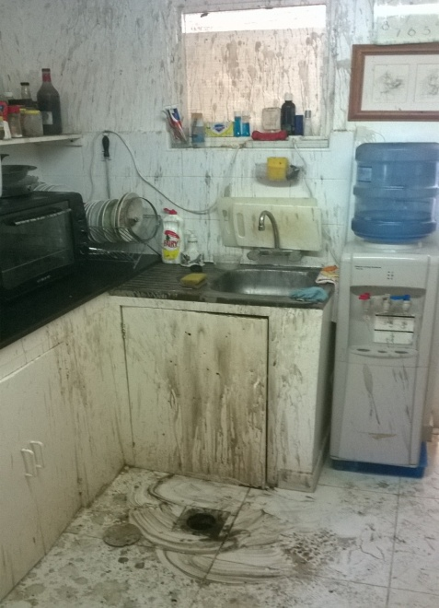


PDO Incident First Alert
Incident type | LTI (#37) | PIM ID | 1090894
Date/ time | 15/09/2015 (09:30 hrs) | Directorate
Location | Ras Al Hamra | Dept
What happened
To clear a blocked floor drain in a maids kitchen a plumber poured acid based drain cleaner down the drain. It reacted violently with something in the drain which then lead to an explosion spraying the plumber with the acid causing severe chemical burns.
Mr. Musleh asks the questions of can it happen to you?
Do you have all the information before you start?
Do you ensure you have the correct tools and chemicals for the task?
Do you have the correct PPE for handling chemicals?
Do you ensure you are out of the line of fire?
Do you think how you might be injured during cleaning activities?
Splash pattern
Drain where chemicals erupted from
Please disseminate this LTI notification to your teams and use it in your tool box talks and HSE meetings and notice boards.

