Slide 1
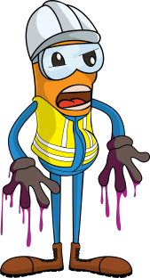
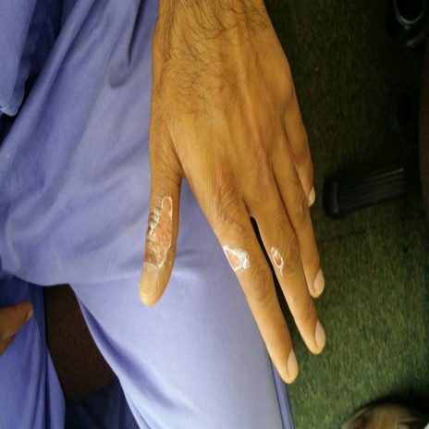


PDO Incident First Alert
Incident type | LTI (#38) | PIM ID | 1090884
Date/ time | 22/08/2015 (10:30 hrs) | Directorate
Location | Ras Al Hamra Club | Dept
What happened
Whilst attempting to unblock a drain on the Ras Al Hamra Club roof a worker spilled drain cleaner on his hand and the chemical burnt his fingers. He did not realize the chemical was hazardous as he had not been trained and so did not ensure the necessary safeguards.
Mr. Musleh asks the questions of can it happen to you?
Do you check you have been given the right chemical for the job?
Do you read the label before using any new chemical?
If the label says ‘hazardous’ then do you ask your supervisor for the safety information and get the necessary controls to protect you?
Burns from the drain cleaner
Please disseminate this LTI notification to your teams and use it in your tool box talks and HSE meetings and notice boards.

