Slide 1

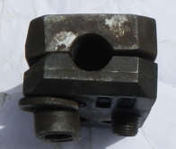
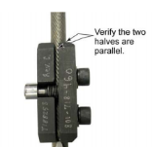
PDO Safety Advice
Use this Advice: Discuss in Tool Box Talks and HSE Meetings ➔ Distribute to contractors ➔ Post on HSE Notice Boards
Incorrect installation
Two halves are not parallel
Date:23.06.2015
LTI: Amputated fingers
What happened?
During the process of installing a snatch pulley, the cable slipped from the cable clamp trapping the employee’s hand between the CSES (cable side entry sub) and the cable resulting in the amputation of two fingers.
Your learning from this incident.
Follow the standard work instruction procedures for all tasks. (Proper installation of cable clamp and performing of pull test)
Perform a detailed risk analysis based on rig floor setup.
Ensure cable clamp is installed correctly
Correct clamp installation
Contact MSE34 for further information Learning No 32 23/06/2015

Slide 2
Management learning's
Distribute to contractors ➔ Post on HSE Notice Boards
Date:23.06.2015
LTI: Amputated fingers
As a learning from this incident and ensure continual improvement all contract
managers are to review their HSE HEMP against the questions asked below:
Do your employees follow the Standard Work Instructions?
Are your supervisors competent in conducting risk assessment?
Do your supervisors understand and apply MOC process when required?
Do your supervisors get involved during critical tasks of the operations?
Learning No 32 23/06/2015

