Slide 1
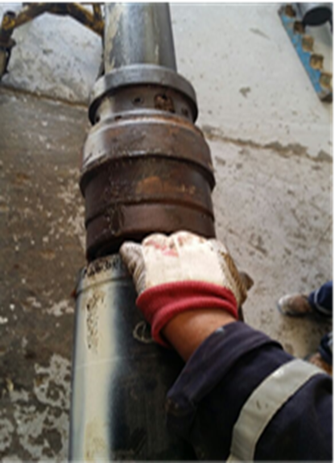
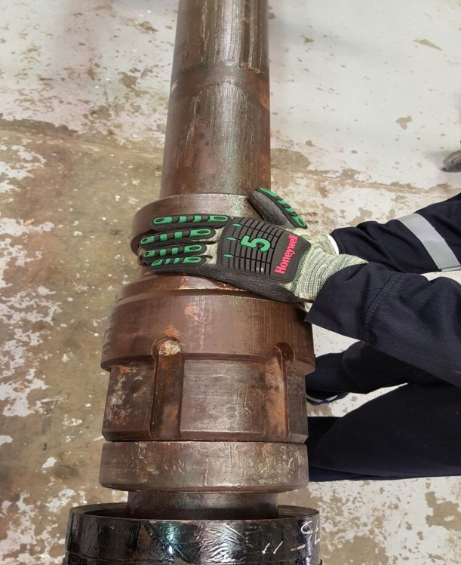
PDO Safety Advice
Use this Advice: Discuss in Tool Box Talks and HSE Meetings ➔ Distribute to contractors ➔ Post on HSE Notice Boards
Date: 05.08.2015
LTI: Amputated finger
What happened?
In the process of fitting the Polymer into the junk cover, an engineer loosened the screws from the junk cover and secured it with only 1 screw. Once the fitting of the Polymer was complete, he observed one of the crew with his fingers in a pinch point area (between the hanger & junk cover), he decided to intervene and show him the hazard associated with pinch points. While doing so junk cover dropped and struck the engineers left hand little finger.
Your learning from this incident.
Identify the hazards of work area before starting the task
Never place your hands & fingers at pinch points
Always include hands & fingers in TBT meeting.
Don’t Put yourself at risk while you are demonstrating the hazard to others
Contact MSE34 for further information Learning No 33 05/08/2015

Slide 2
Management learning's
Distribute to contractors ➔ Post on HSE Notice Boards
Date: 05.08.2015
LTI: Amputated finger
As a learning from this incident and ensure continual improvement all contract
managers are to review their HSE HEMP against the questions asked below
Confirm the following:
Does JSA include securing method of junk cover?
Does your company have a specific procedure for running liner hanger ?
Do your TBT’s cover hands and fingers related hazards?
Contact MSE34 for further information Learning No 33 05/08/2015

