Slide 1
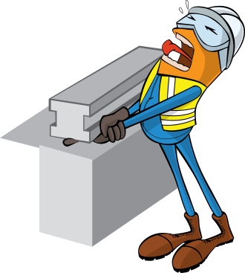
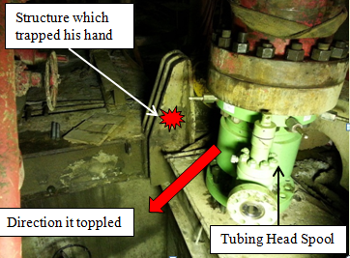
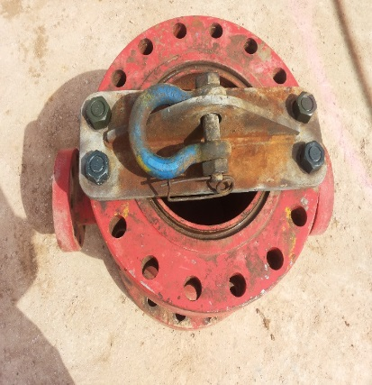
PDO Safety Advice
Use this Advice: Discuss in Tool Box Talks and HSE Meetings ➔ Distribute to contractors ➔ Post on HSE Notice Boards
Date: 27.06.2015
LTI: Crushed Finger
What happened?
As the forklift placed a tubing head spool down on work area, it began to topple over towards the cellar. The driller tried to stop it toppling and in doing so his hand was crushed between the spool and an upright part of the rig structure, injuring his left hand.
Your learning from this incident..
Use the correct lifting device for such loads.
Use empowerment to STOP to be used.
Supervisors to supervise.
Use the correct lifting device for the load
Contact MSE34 for further information Learning No 37 27/06/2015

Slide 2
Management learning's
Distribute to contractors ➔ Post on HSE Notice Boards
Date: 27.06.2015
LTI: Crushed Finger
As a learning from this incident and ensure continual improvement all contract
managers are to review their HSE HEMP against the questions asked below
Confirm the following:
Can lifting tasks be done using hands off method?
Do you conduct a pre-work risk assessment?
Are pinch points identified in the pre-work risk assessment?
If yes, are they discussed during your TBT?
Do your staff understand the empowerment to STOP if a task becomes unsafe?
Contact MSE34 for further information Learning No 37 27/06/2015

