Slide 1
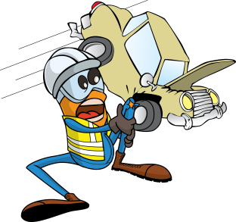
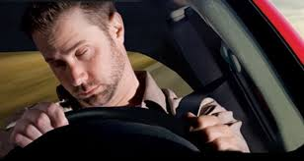
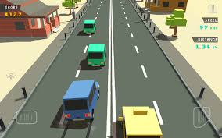
PDO Safety Advice
Use this Advice: Discuss in Tool Box Talks and HSE Meetings ➔ Distribute to contractors ➔ Post on HSE Notice Boards
Date: 21.06.2015
LTI: Multiple injuries
What happened?
A pickup truck travelling between camps veered out of its lane and collided head-on with an upcoming Mitsubishi Canter.
The pick up driver sustained severe multiple injuries and was trapped in his vehicle whilst the other driver and passenger sustained less severe injuries.
Your learning from this incident
Always stop and rest during a trip if you feel fatigued
Follow healthy sleeping advice during Ramadan
Don’t drive if you are tired
Passengers should remain alert during Ramadan to ensure the driver remains focused
Always stop and rest when fatigued
Contact MSE34 for further information Learning No 36 21/06/2015

Slide 2
Management learning's
Distribute to contractors ➔ Post on HSE Notice Boards
Date: 21.06.2015
LTI: Multiple injuries
As a learning from this incident and ensure continual improvement all contract
managers are to review their HSE HEMP against the questions asked below
Confirm the following:
Do you brief your staff about driving while fatigued?
Do you advise your drivers to take rest when fatigued?
Do you conduct regular TBT’s on road safety?
Learning No 36 21/06/2015

