Slide 1
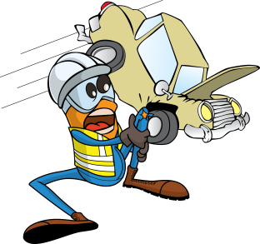
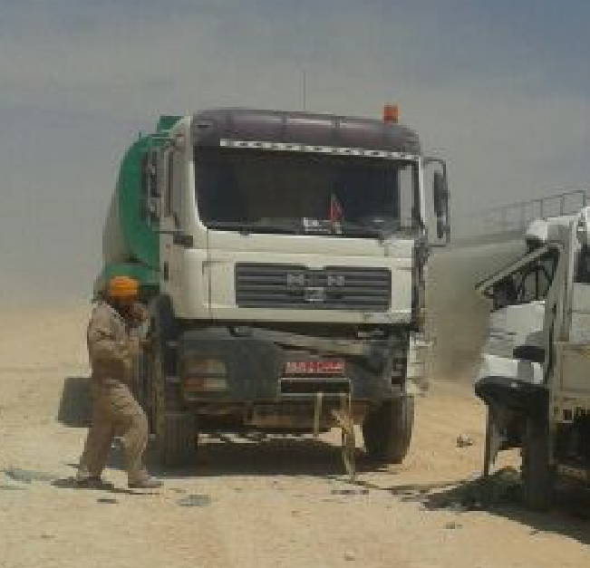
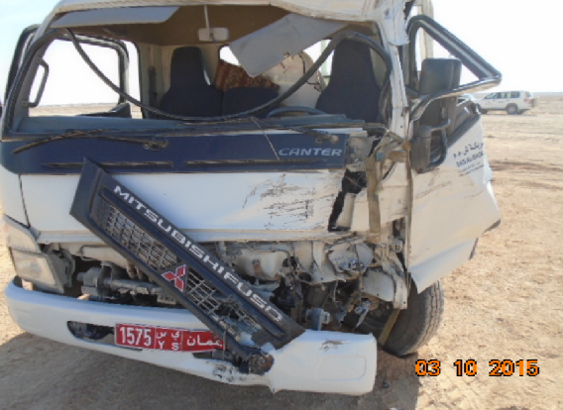
PDO Incident First Alert
Incident type | LTI (#39) | PIM ID | 1091079
Date/ time | 03/10/2015 (10:30 hrs) | Directorate
Location | Thamoud | Dept
What happened
The driver of a 3 tonne Canter truck was travelling behind a tipper truck on a graded road. Due to dust clouds from the vehicle in front he pulled out to the side resulting in a head on collision with an oncoming water tanker causing multiple fractures to the Canter drivers leg and hip.
Mr. Musleh asks the questions of can it happen to you?
Do you adhere to the dust code?
Do you maintain a safe distance behind the vehicle in front?
Do you adapt your driving to accommodate the road conditions?
Do you allow yourself to be distracted by passengers?
Please disseminate this LTI notification to your teams and use it in your tool box talks and HSE meetings and notice boards.

